Slide 1

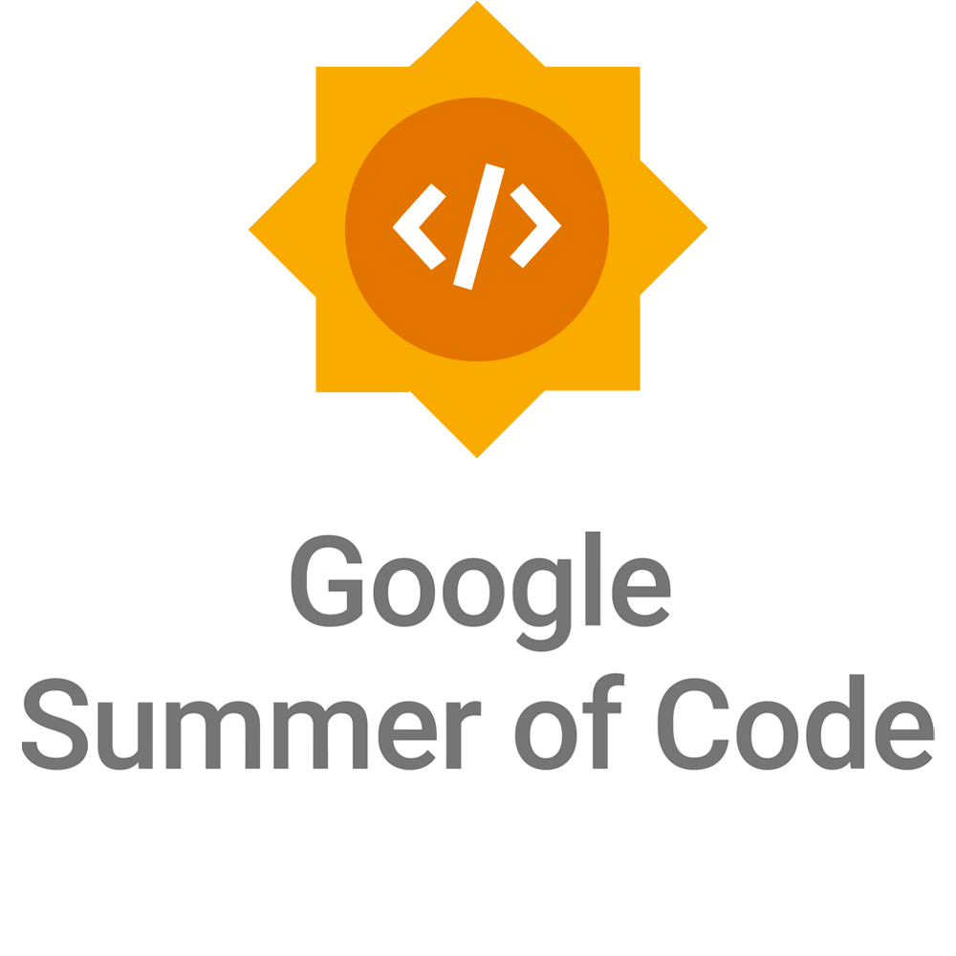
Kickstart your GSOC & open-source journey !!
SAGAR UTEKAR
VMWare Software India PVT. LTD.

Slide 2
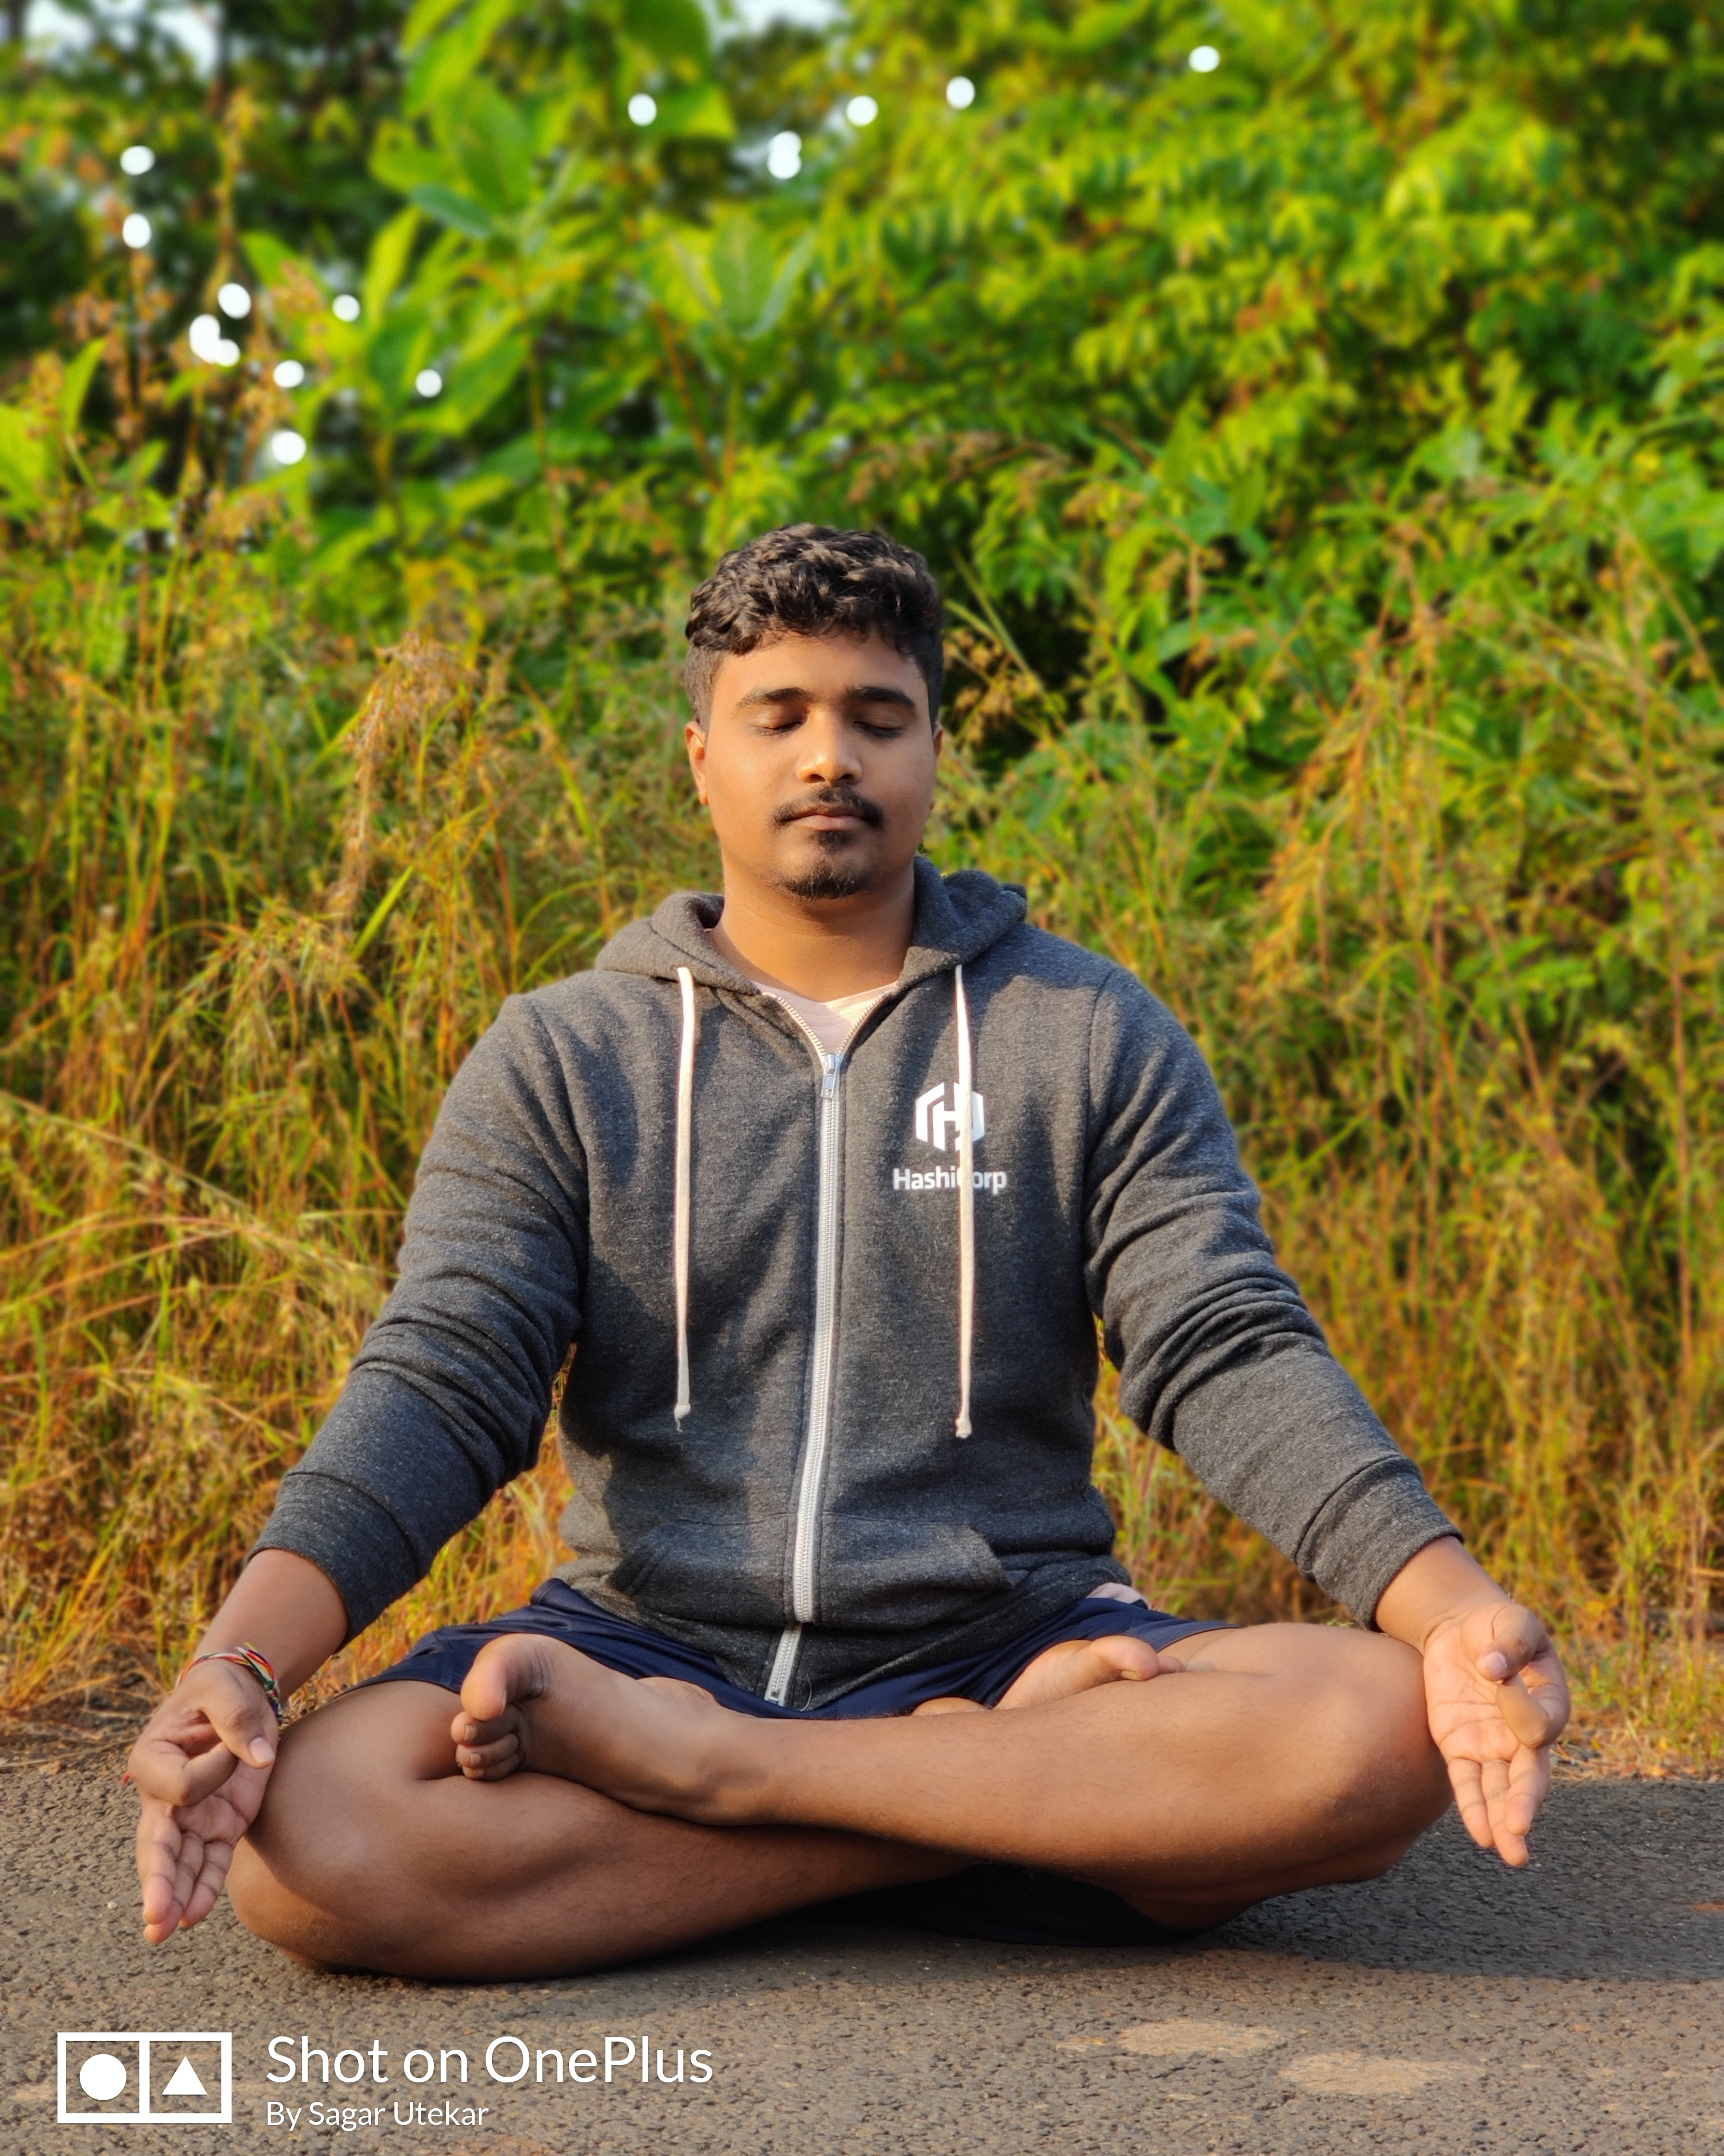
About me
Working as MTS3 Site Reliability Engineer at VMWare Software India PVT. LTD.
Open-Source Enthusiast, A firm believer in the power of community education.
Google Summer Of Code Admin since 2018, Mentor, Mentee 2022 @PEcAn Project
GSoD, GSSoC, Github Externship, SIH mentor
CKS | CKA | CKAD | Terraform Certified
Mentored 5000+ students & professionals across India for career guidance, Job Search, Open Source, Cloud Native
Enjoys photography, Acting, Teaching, Trekking

Slide 3
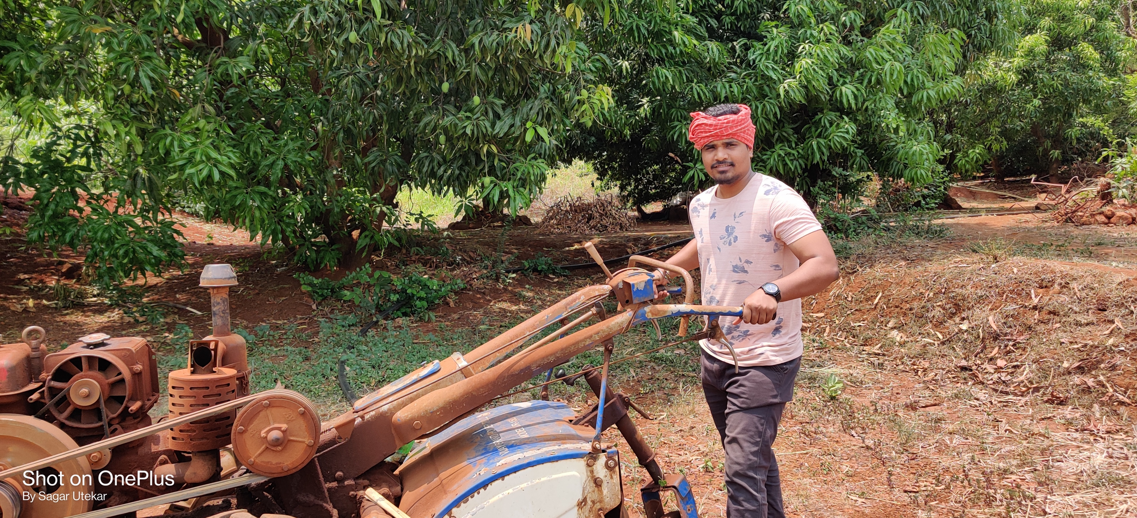
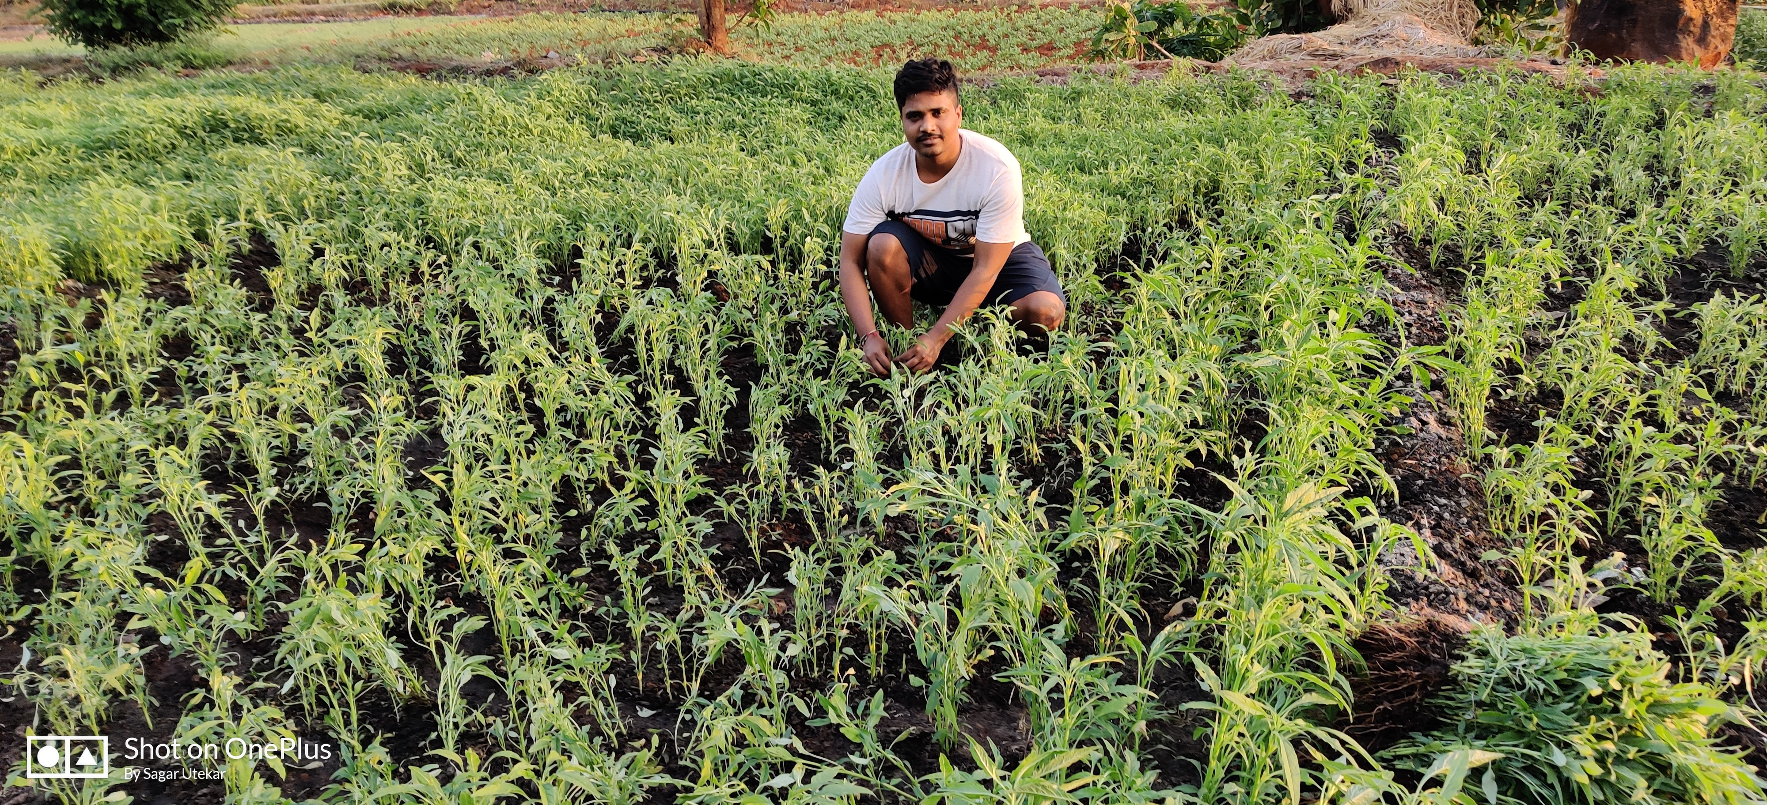
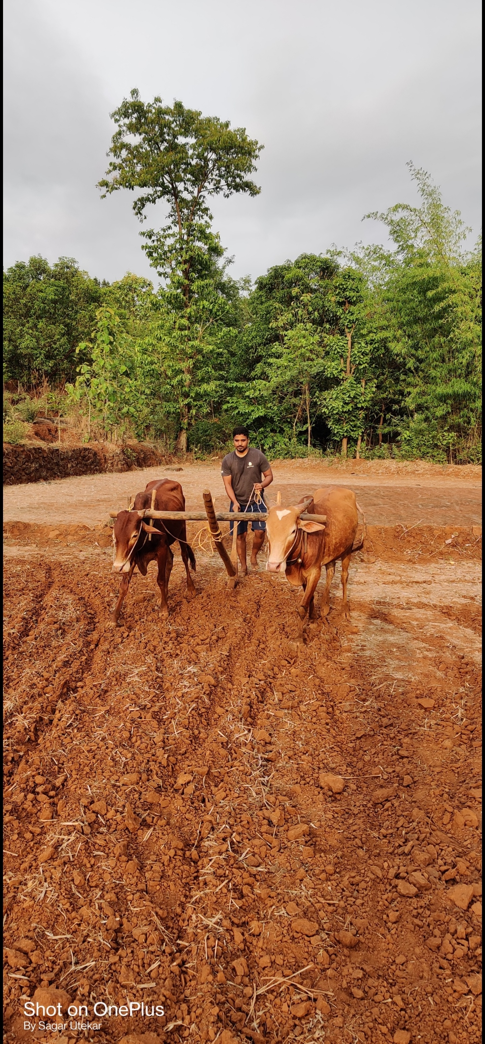
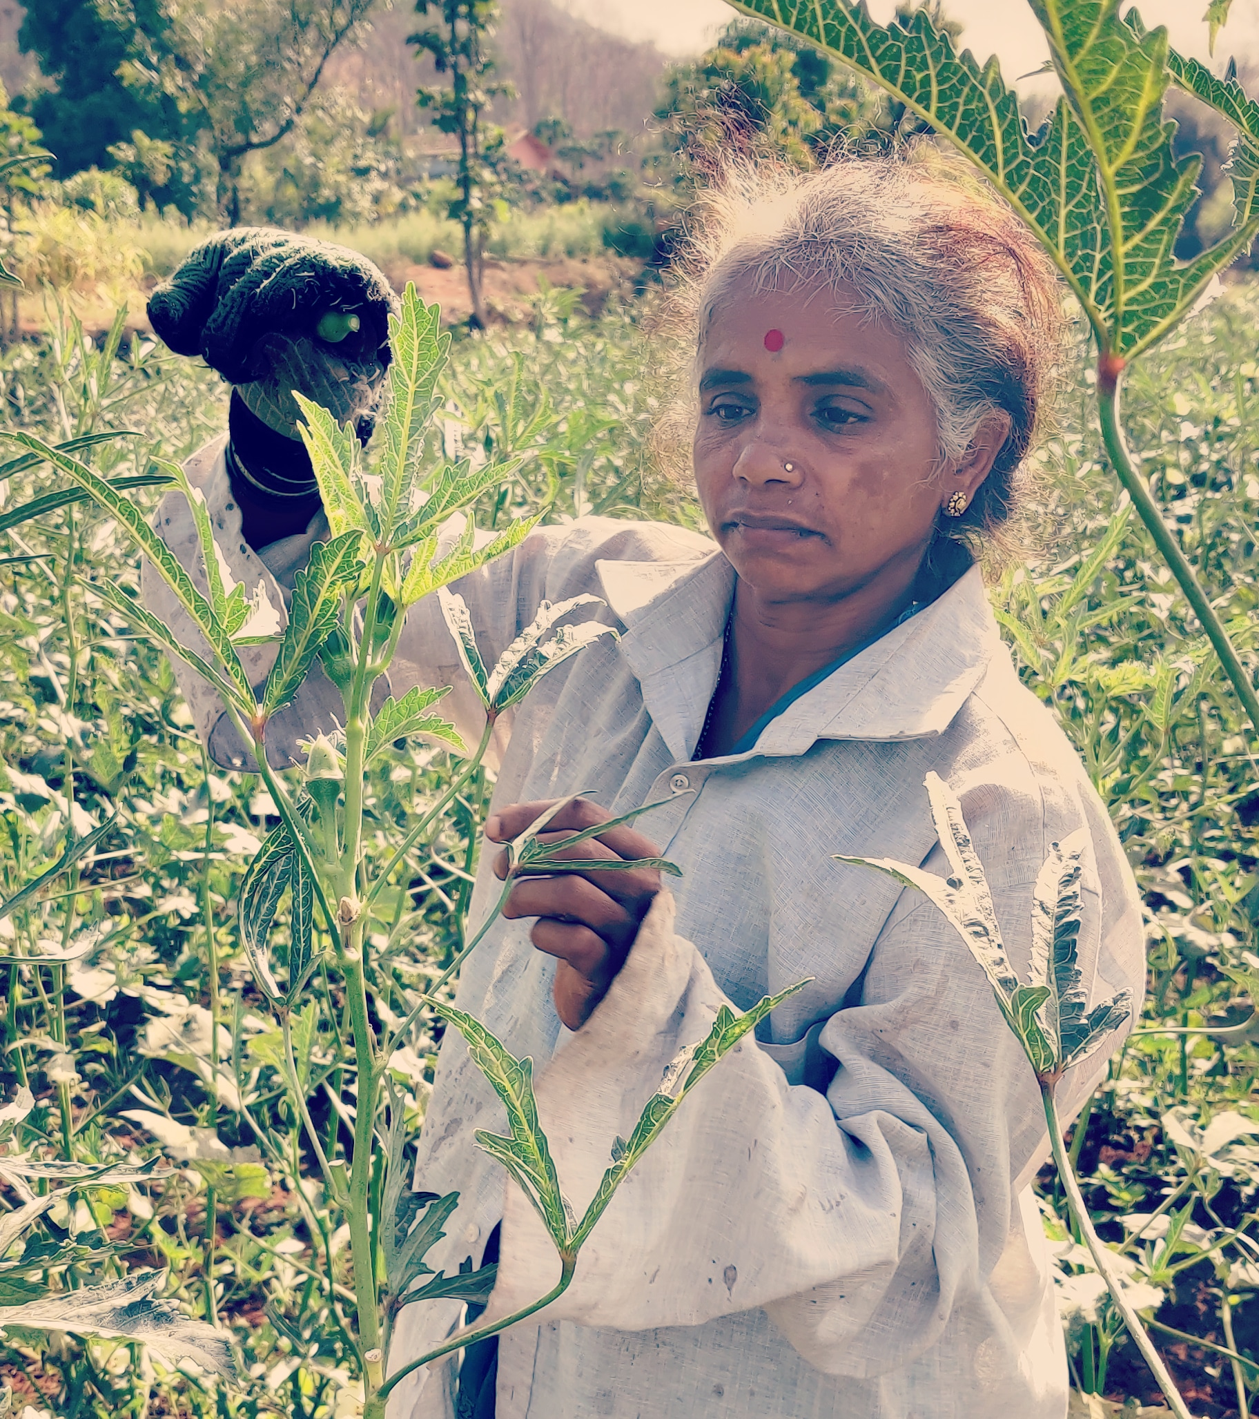
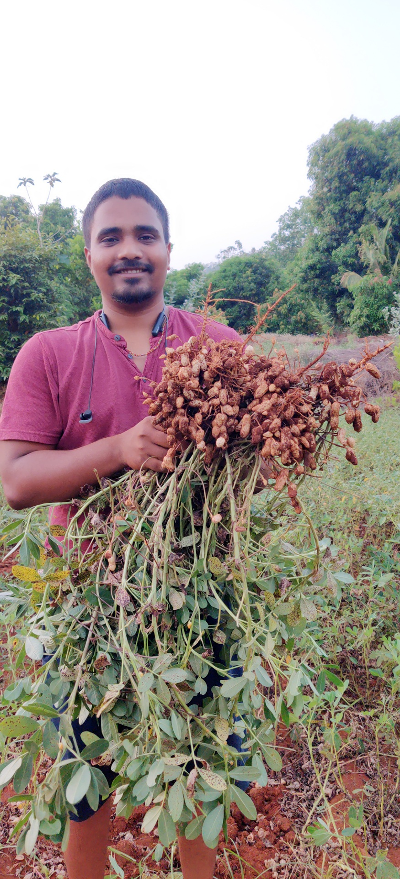
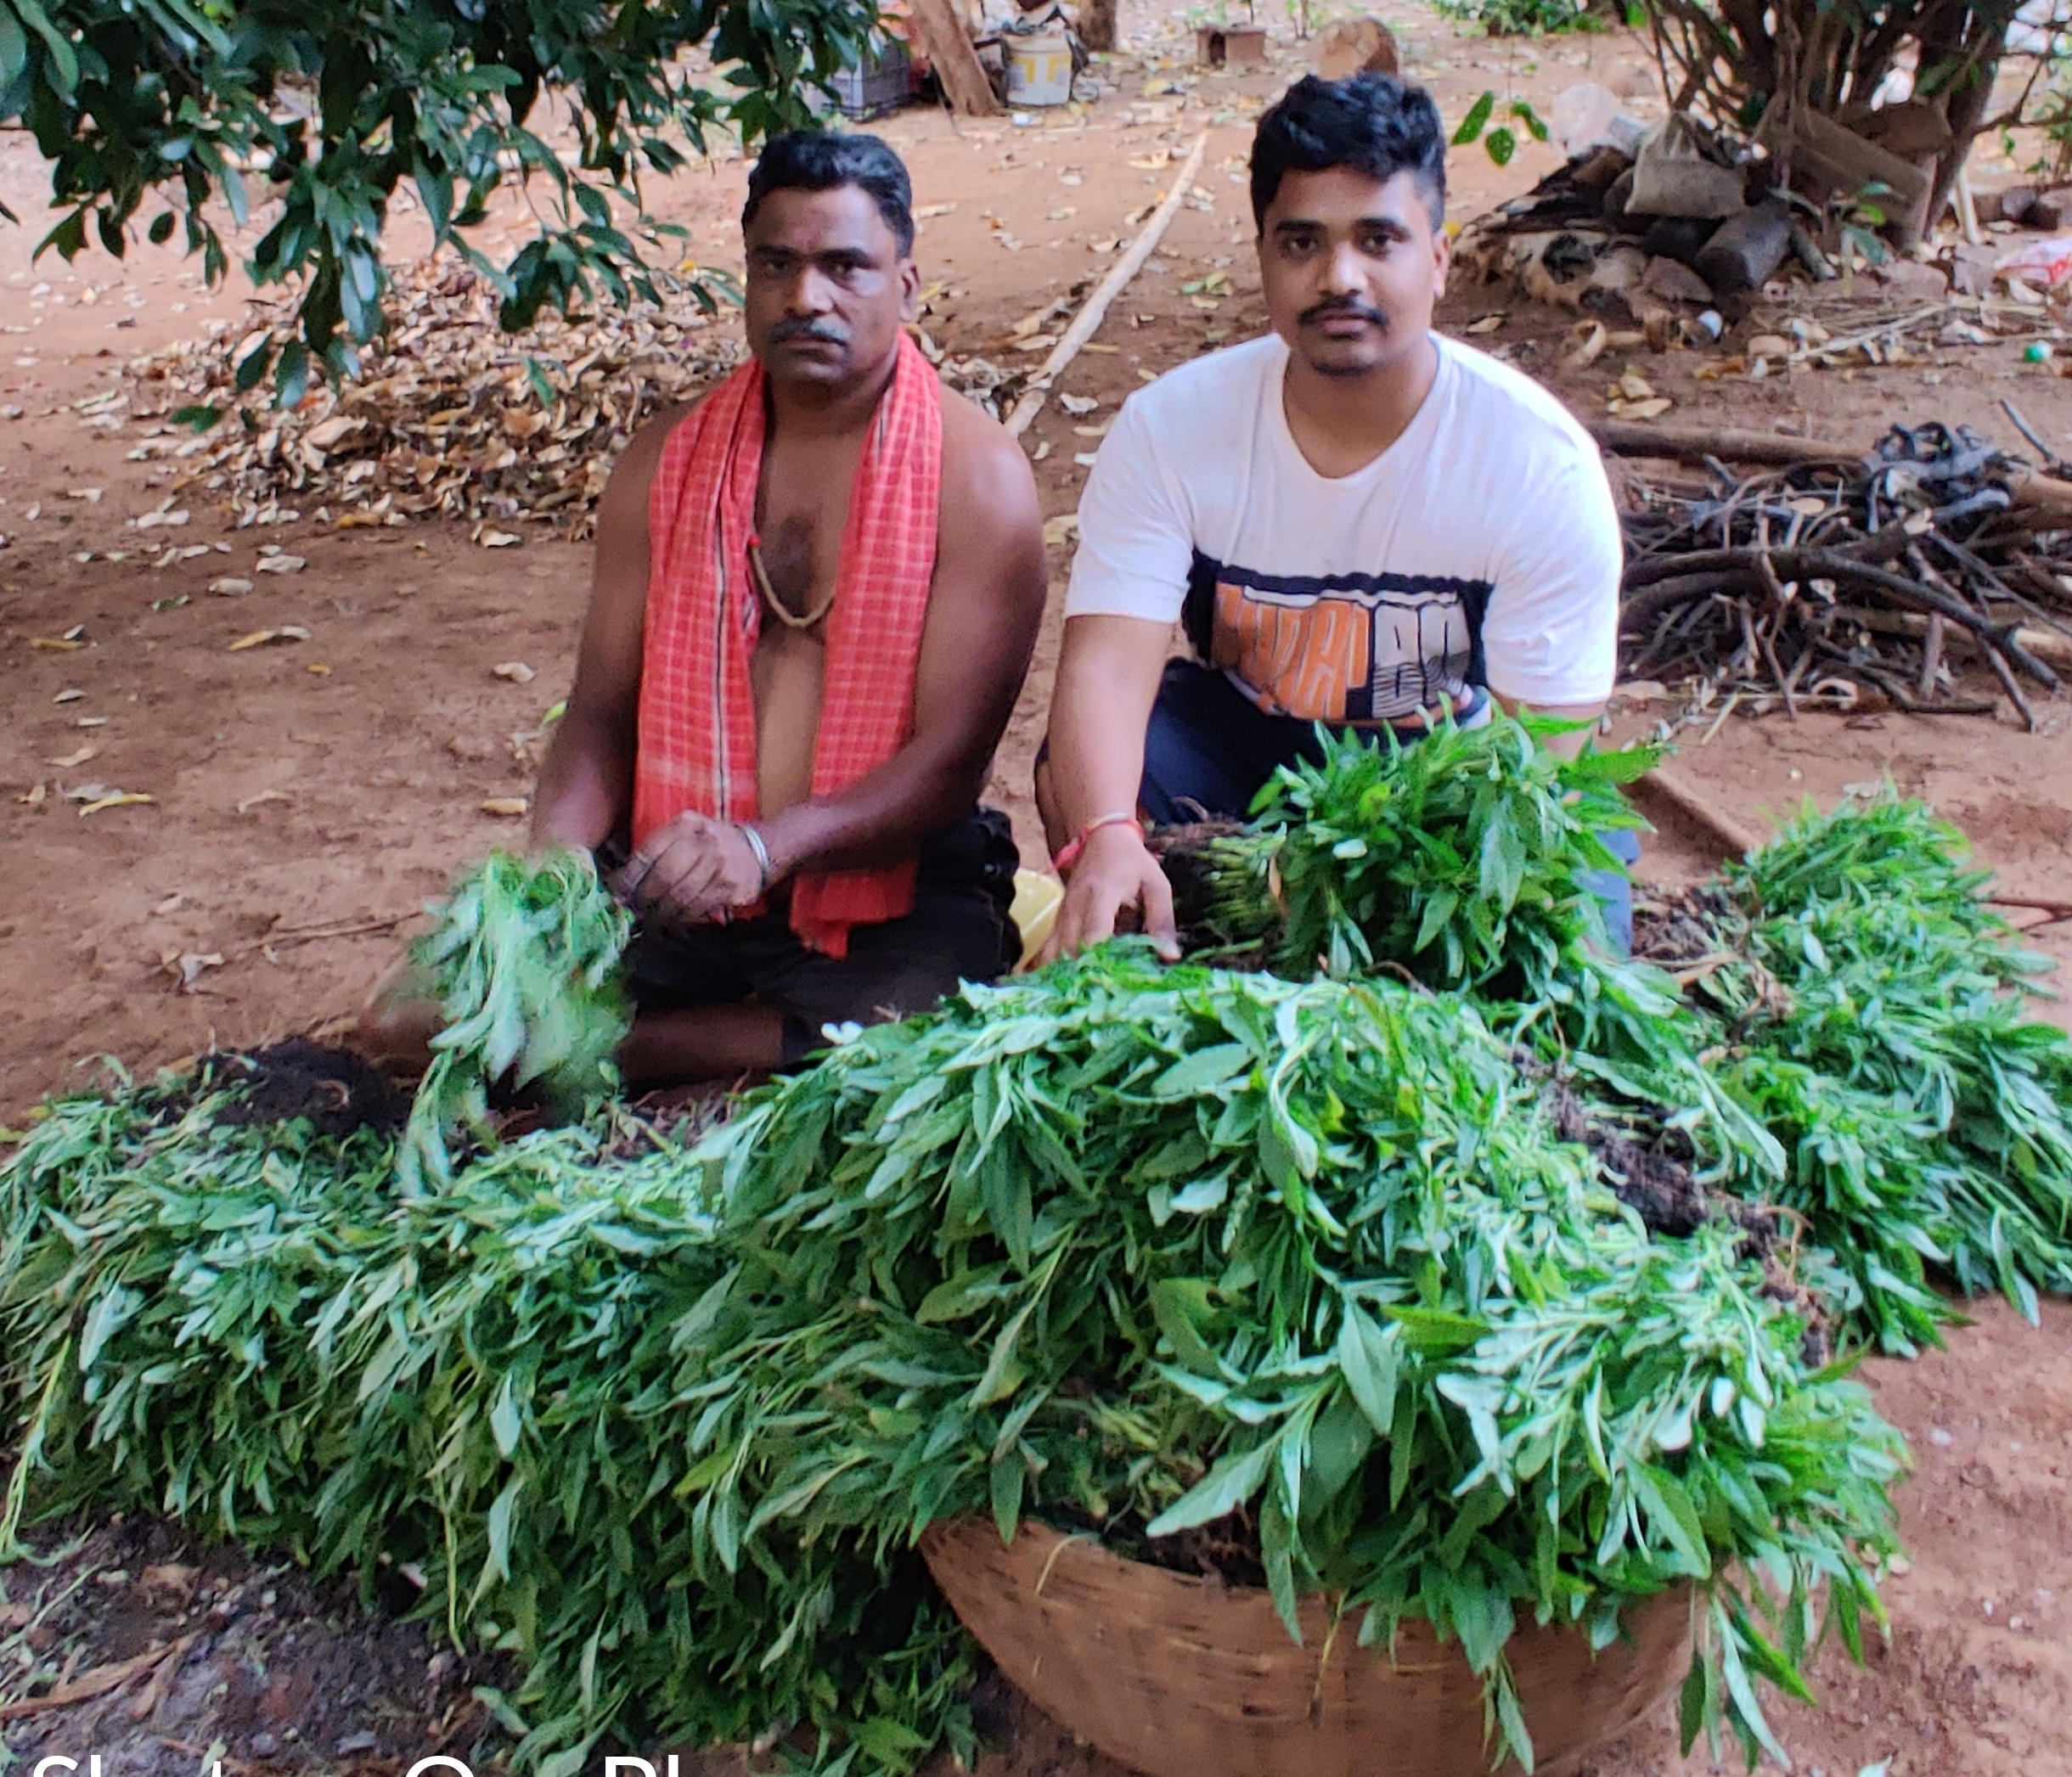
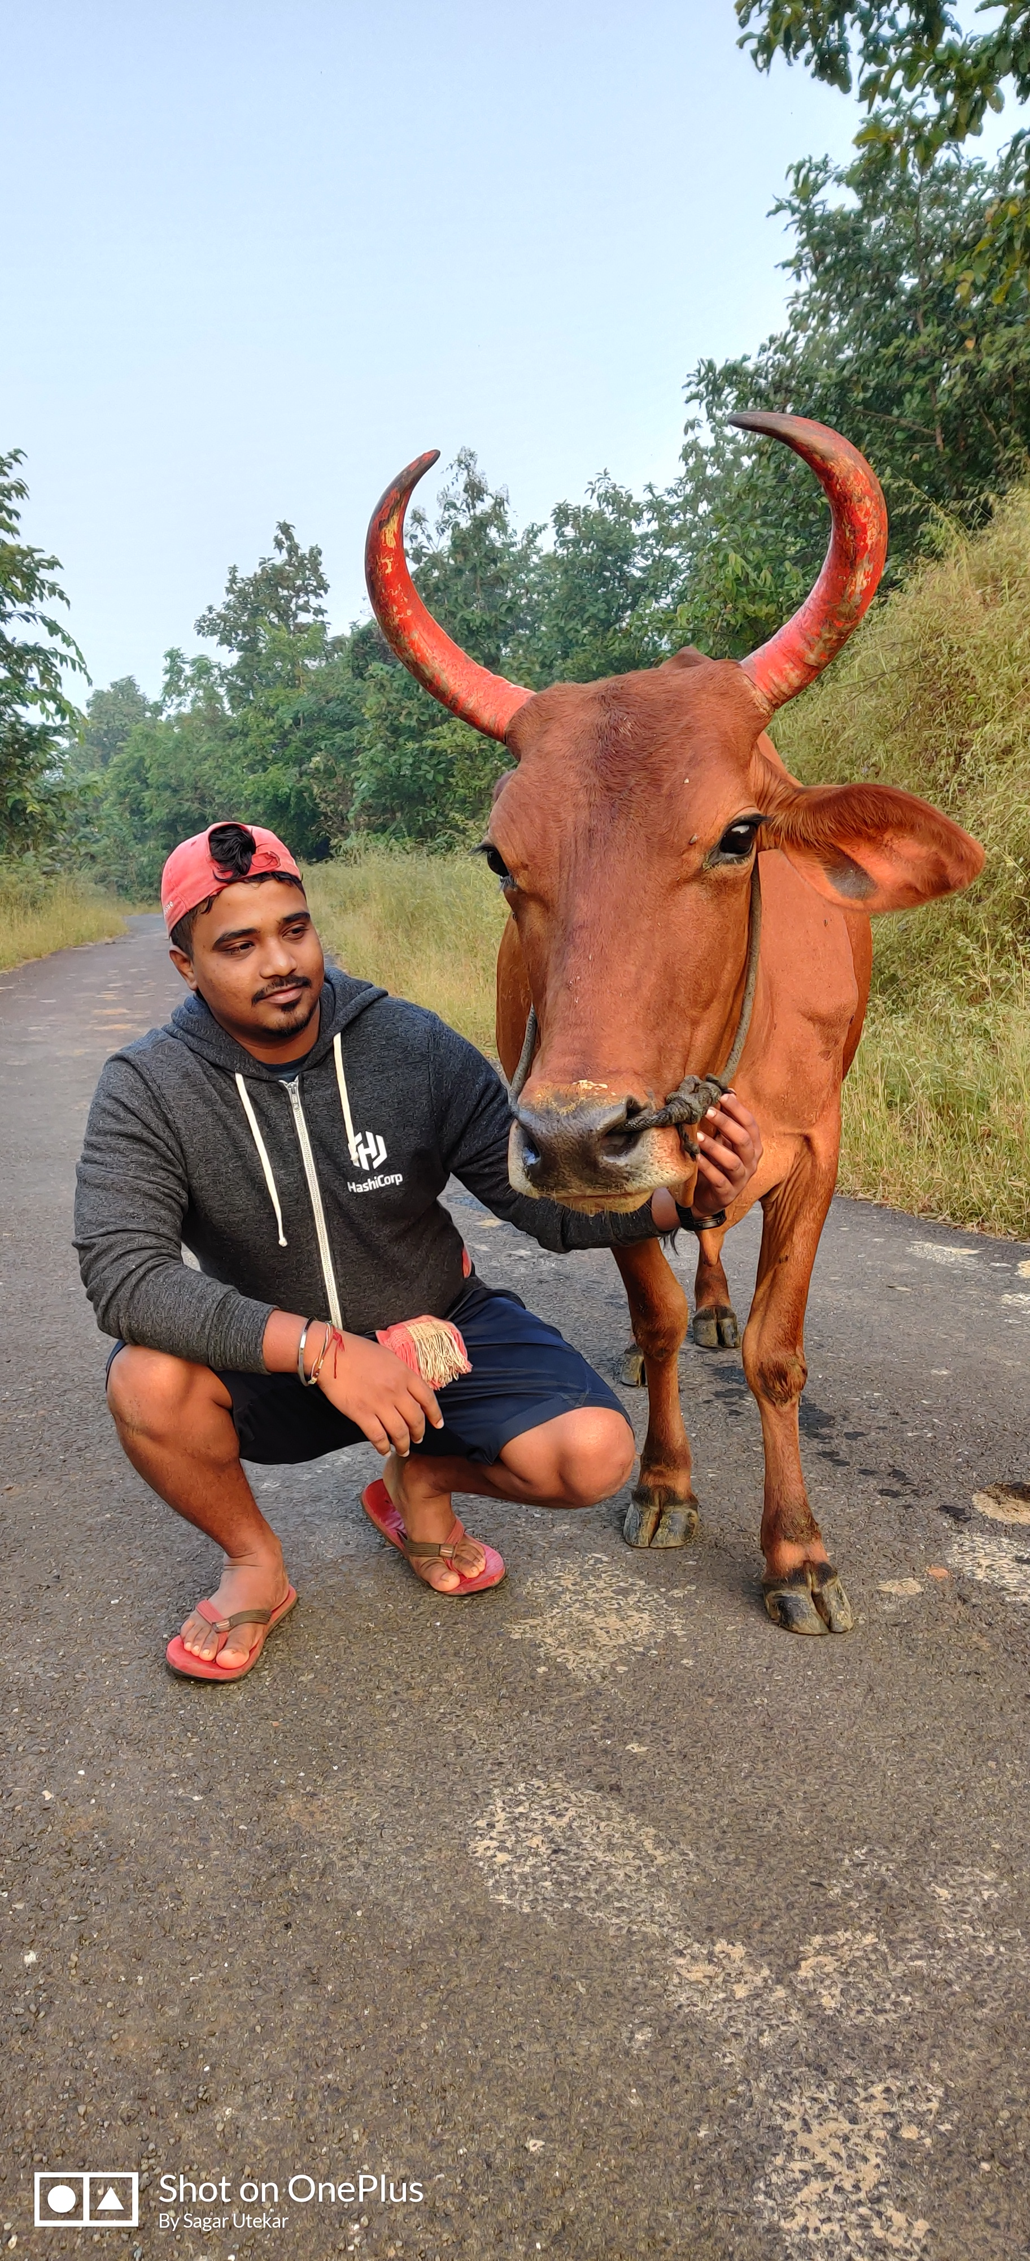
When not doing technical work

Slide 4
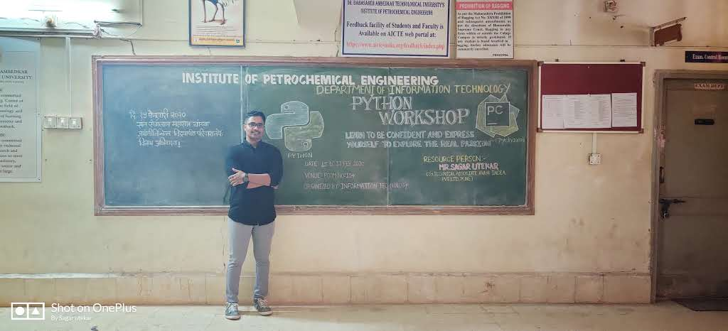
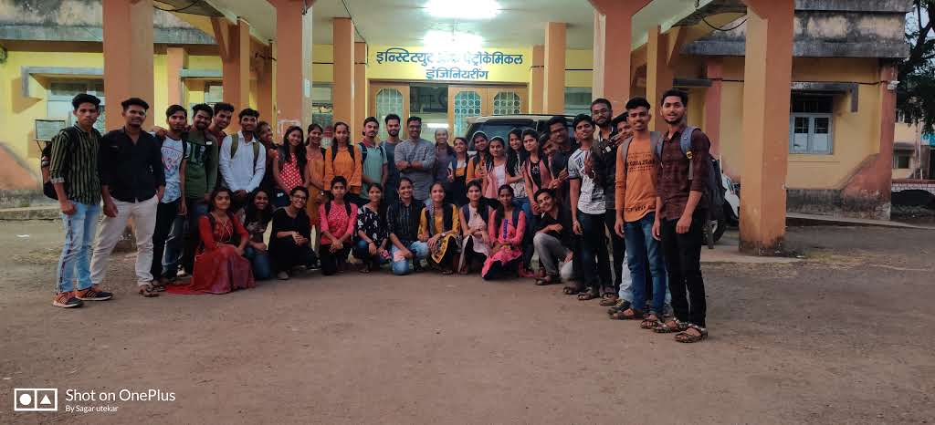
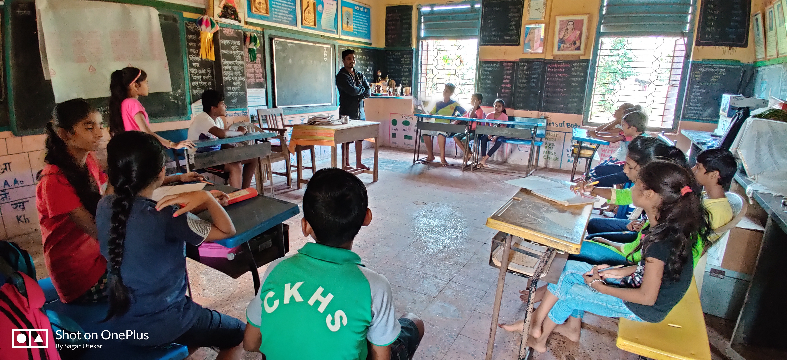
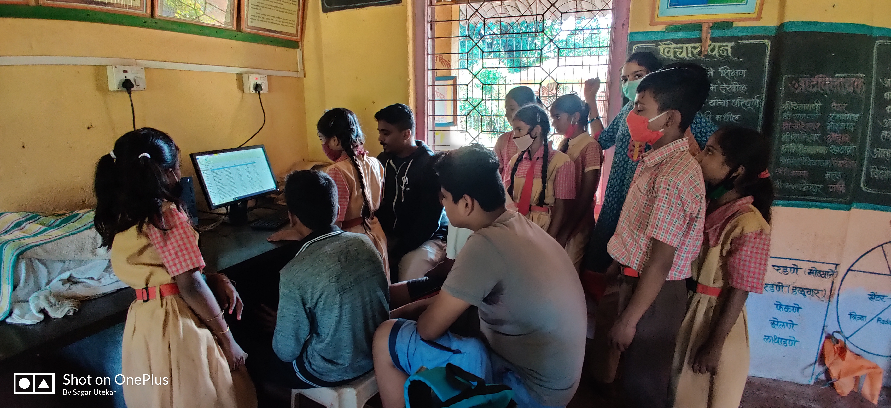
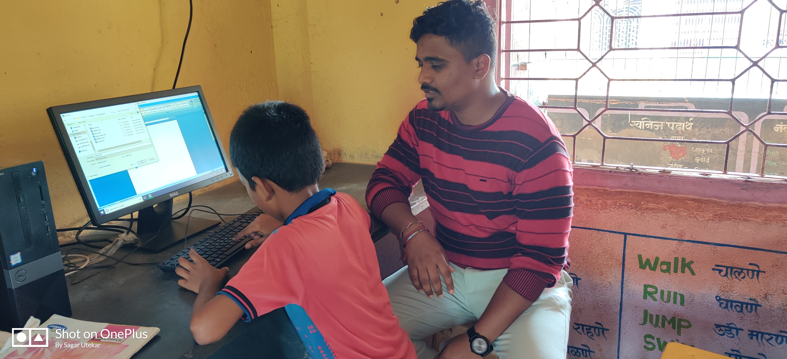
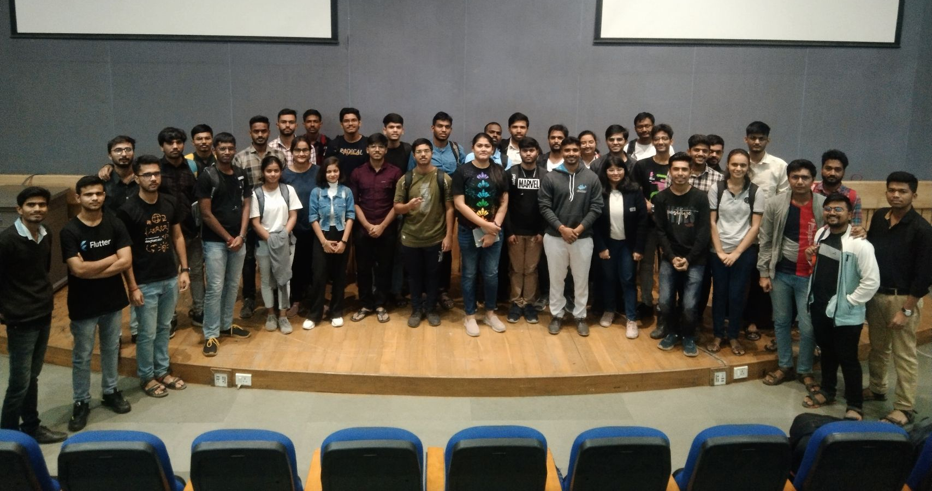
Workshops

Slide 5
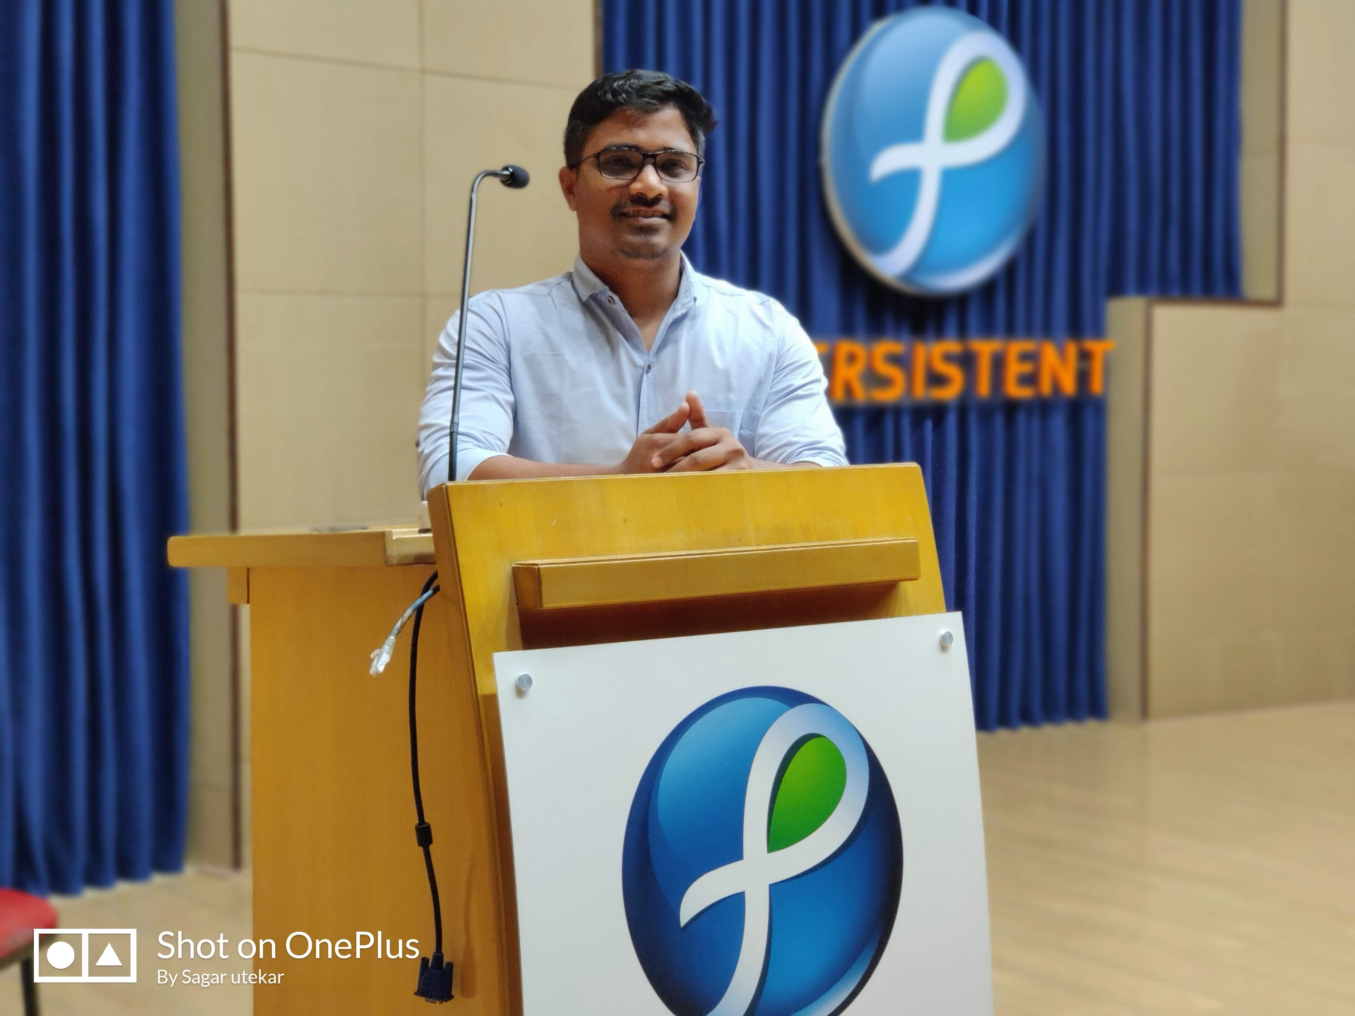
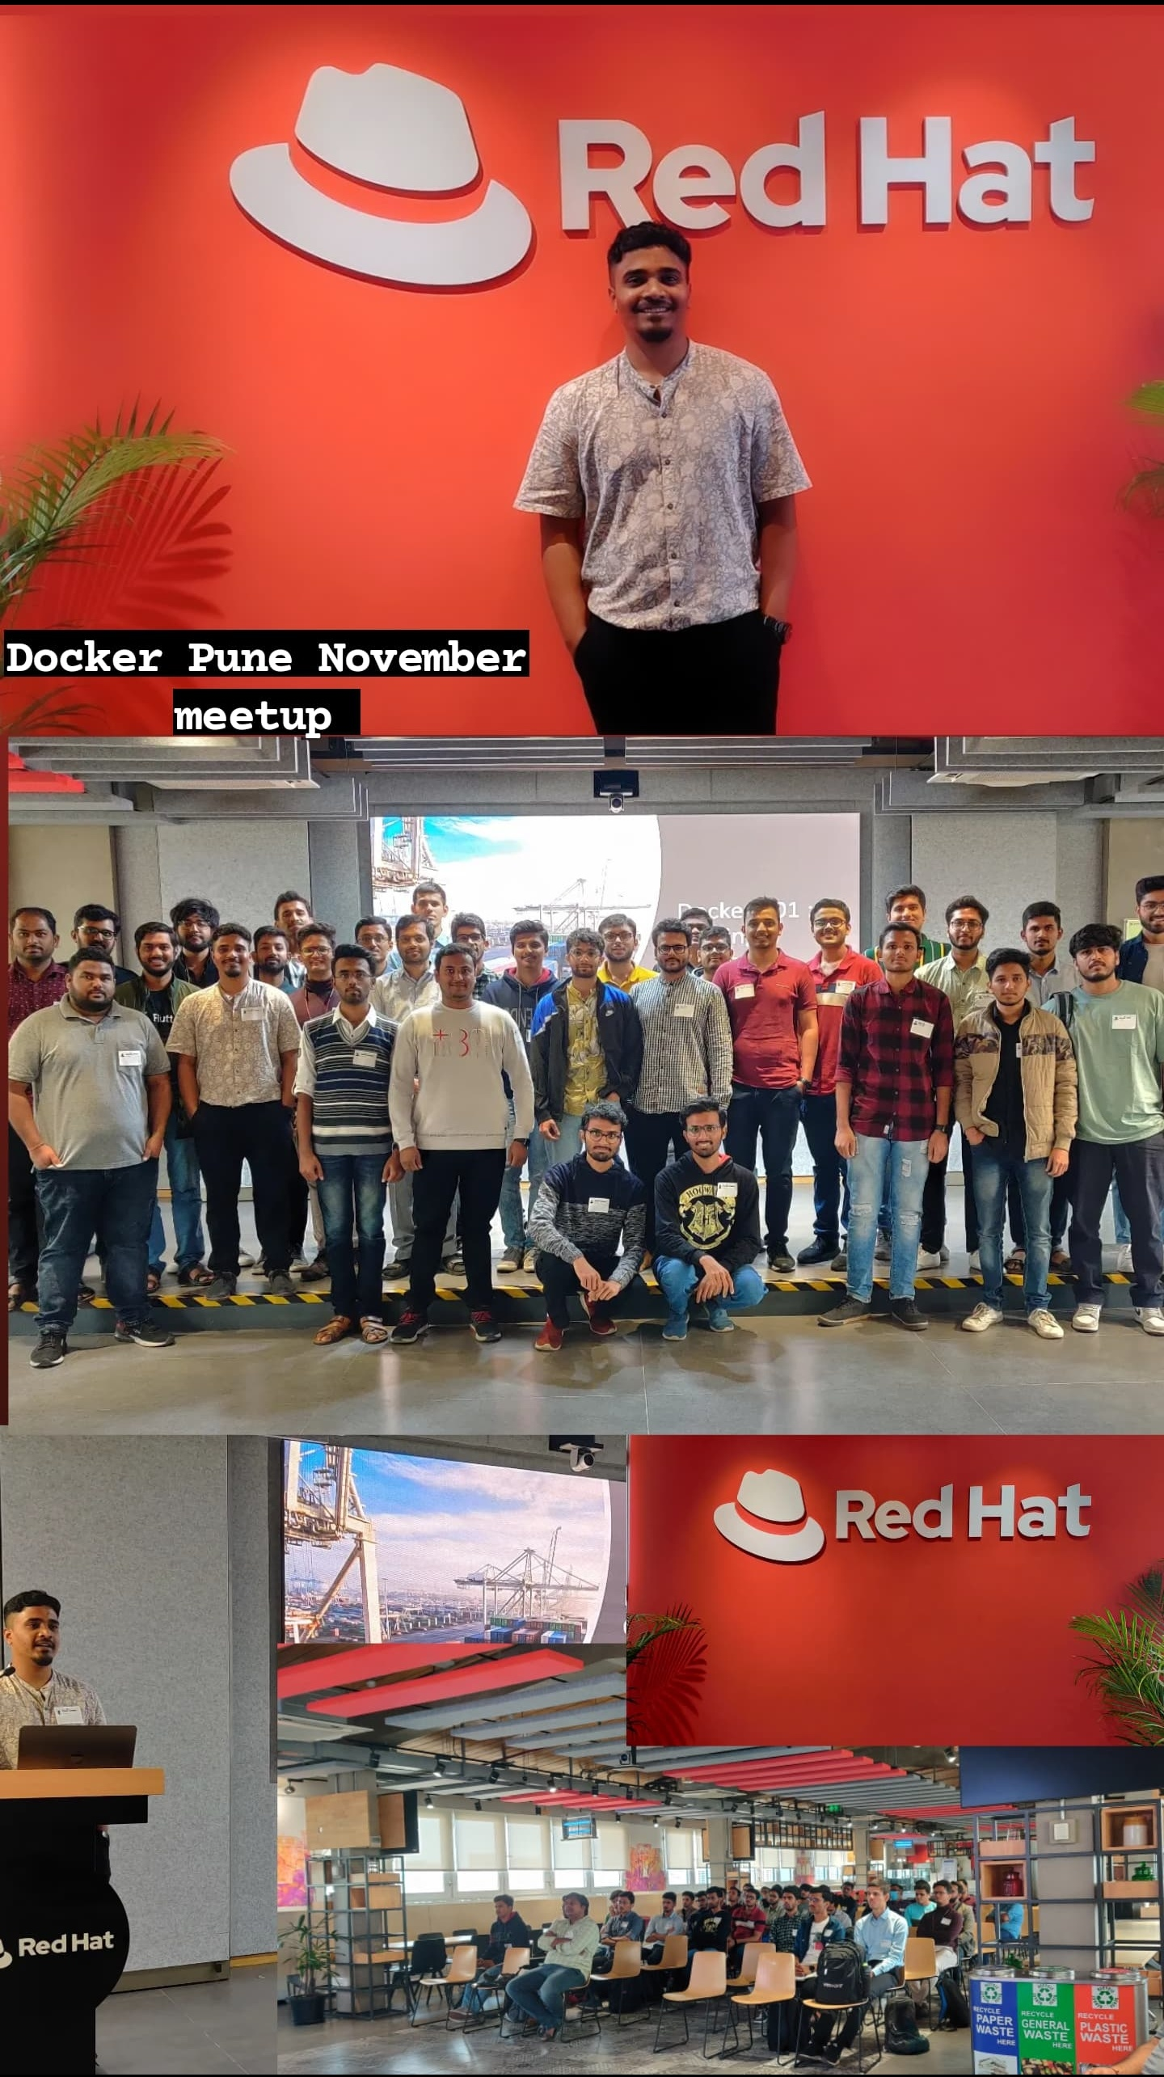
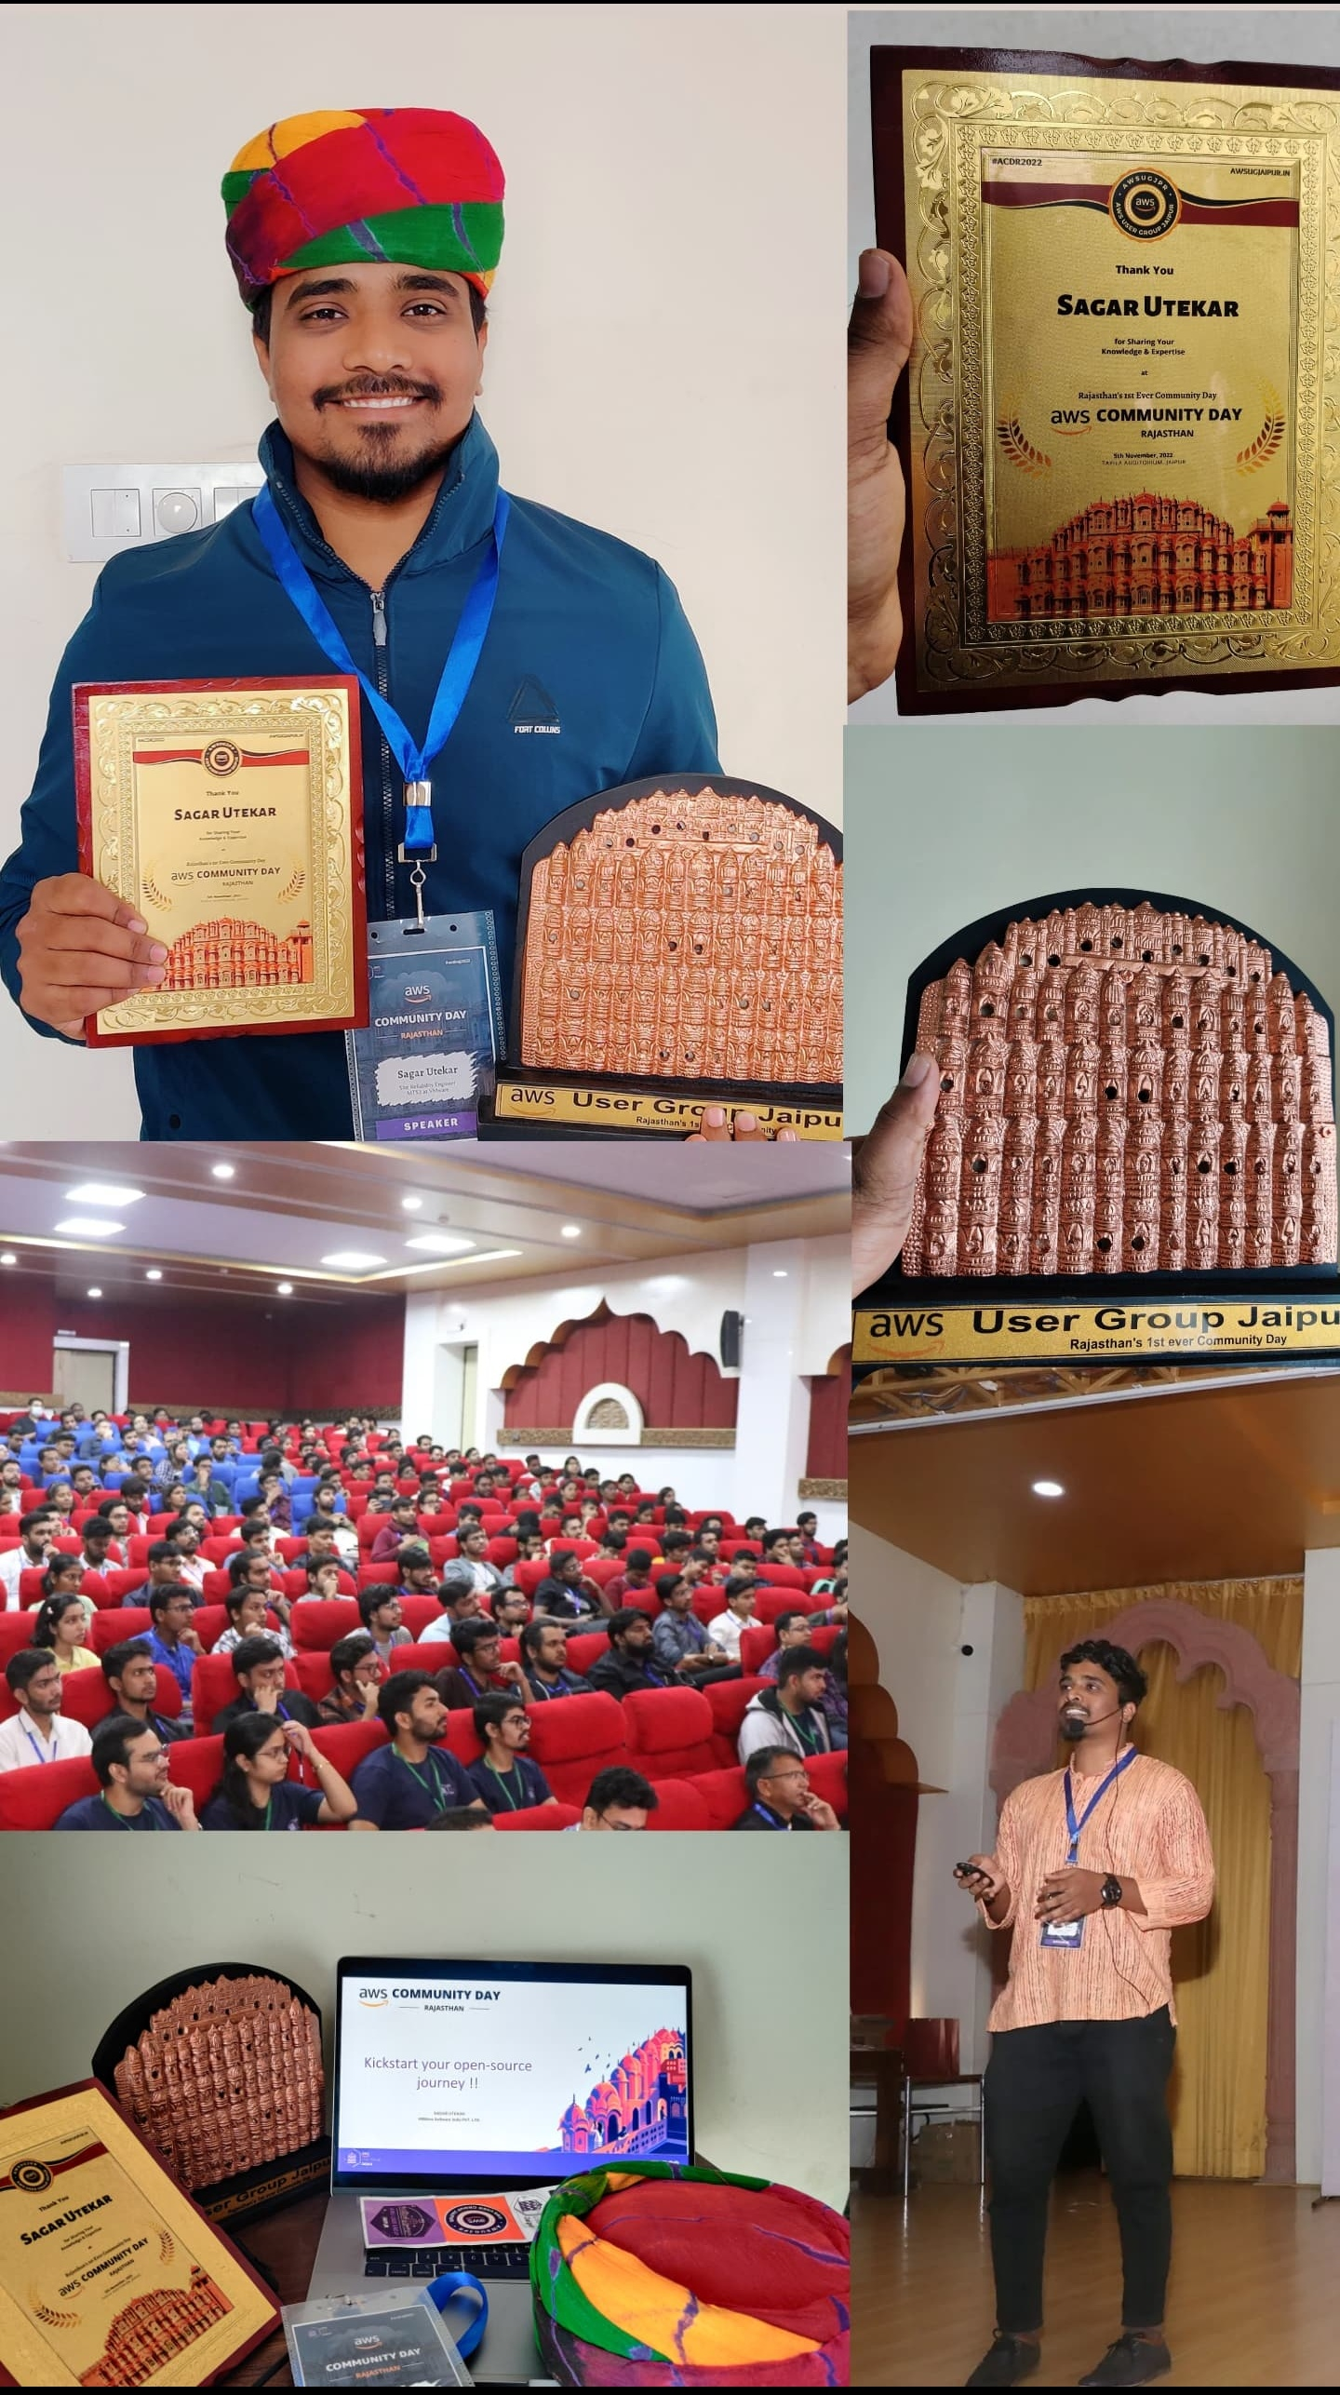
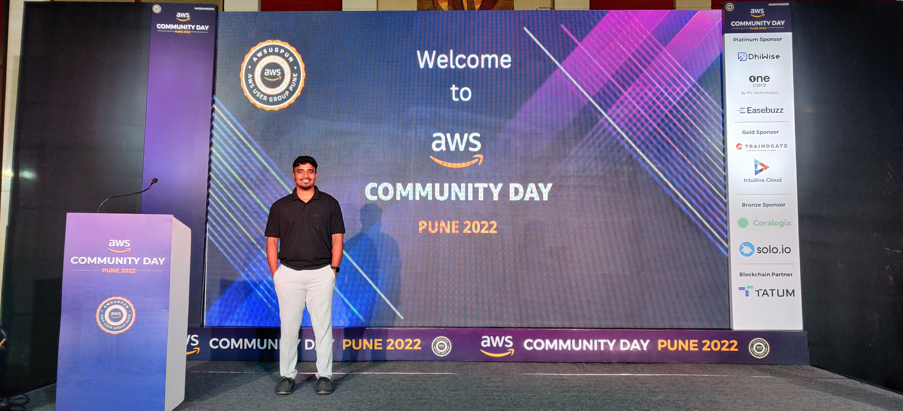
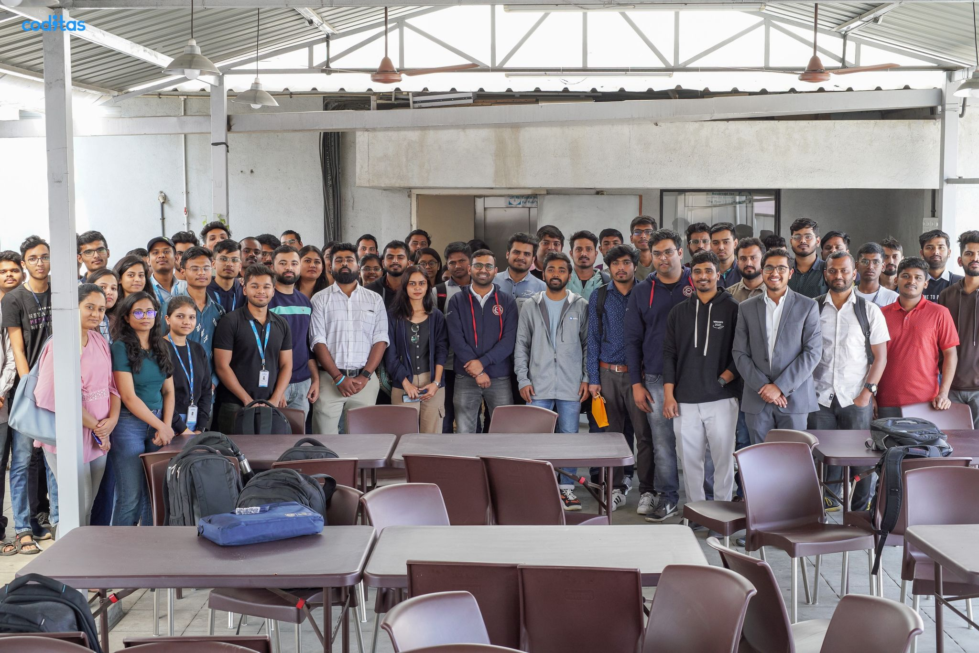
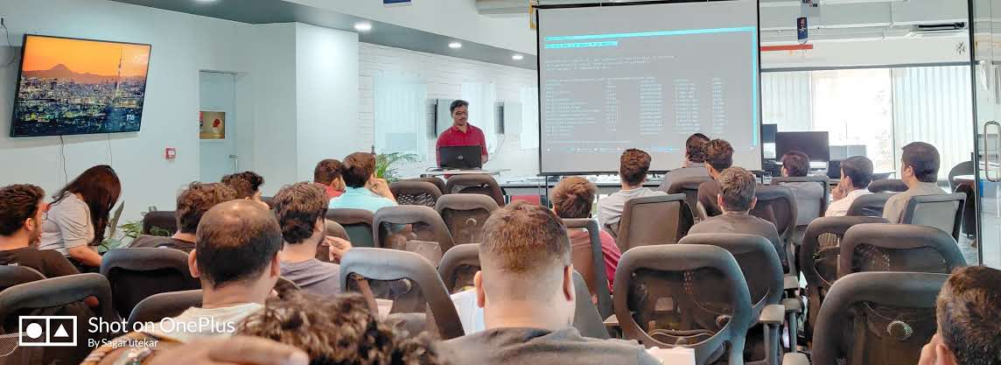
Meetups and events

Slide 6
What’s on the Agenda ?
What is Open-Source Software ?
Benefits of Open-Source contribution
Open-Source Myths
Roles in typical Open-Source project
Open-Source communities & events
GSoC mentor and mentee experience
How to chose an Open-Source project
How to get started with Open Source
Do’s and Don'ts

Slide 7
Q5. Have you heard about Open Source and GSoC before ?
YES
NO

Slide 8
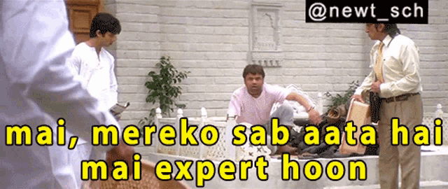

Slide 9
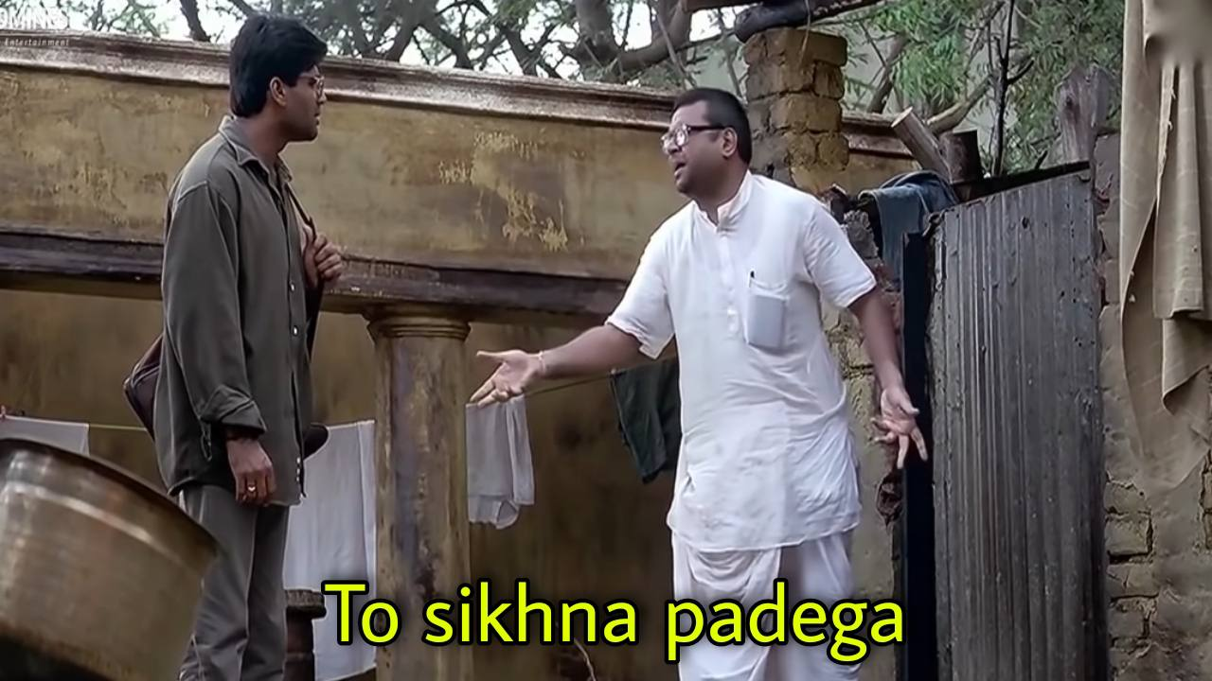

Slide 10
What is Open-Source Software ?
Source code that is made available to public
Decentralized and collaborative
Allow anyone to study, modify, enhance or re-engineer a program’s code and distribute under a permissive license

Slide 11
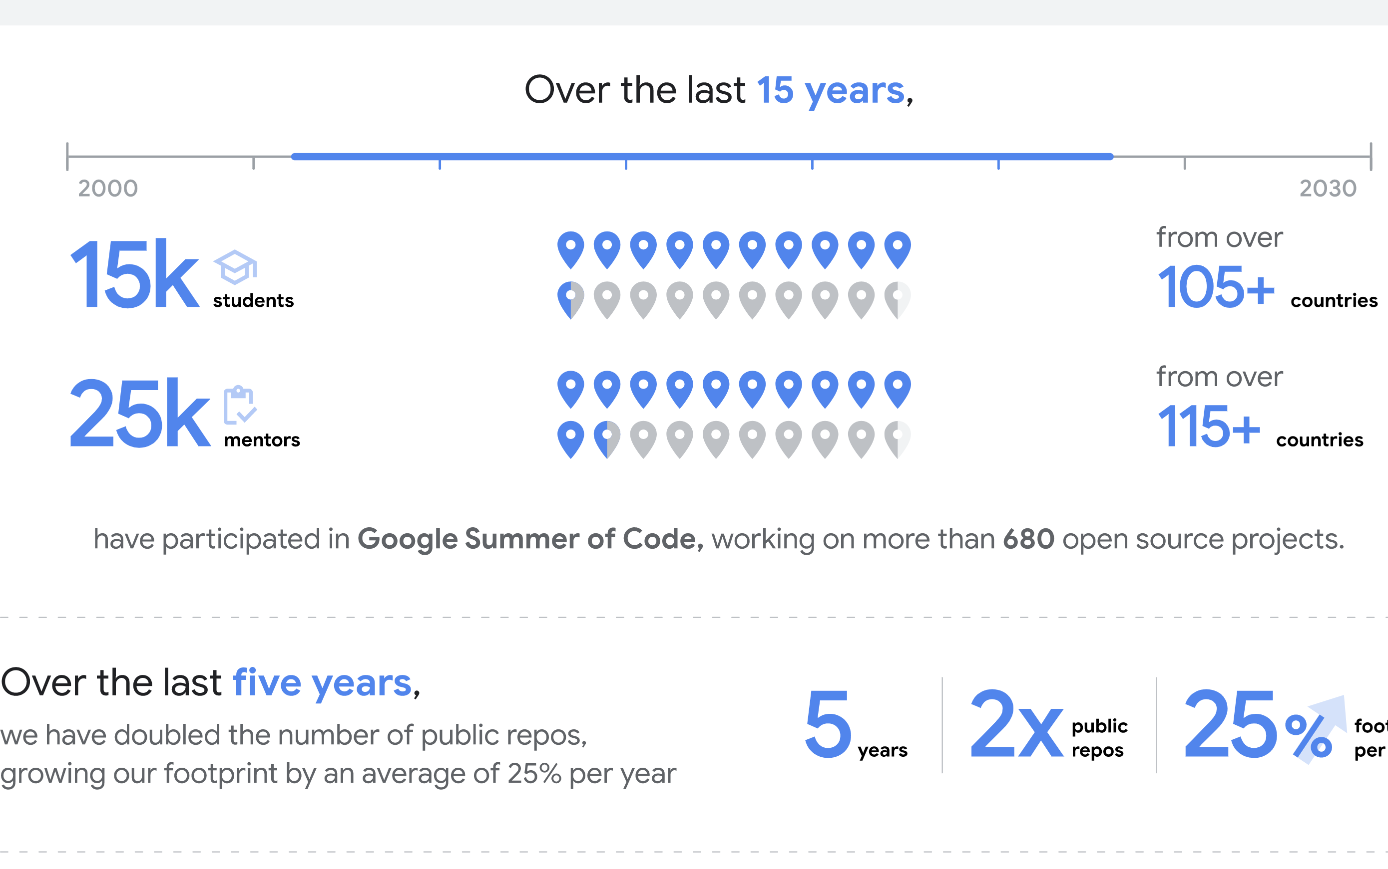
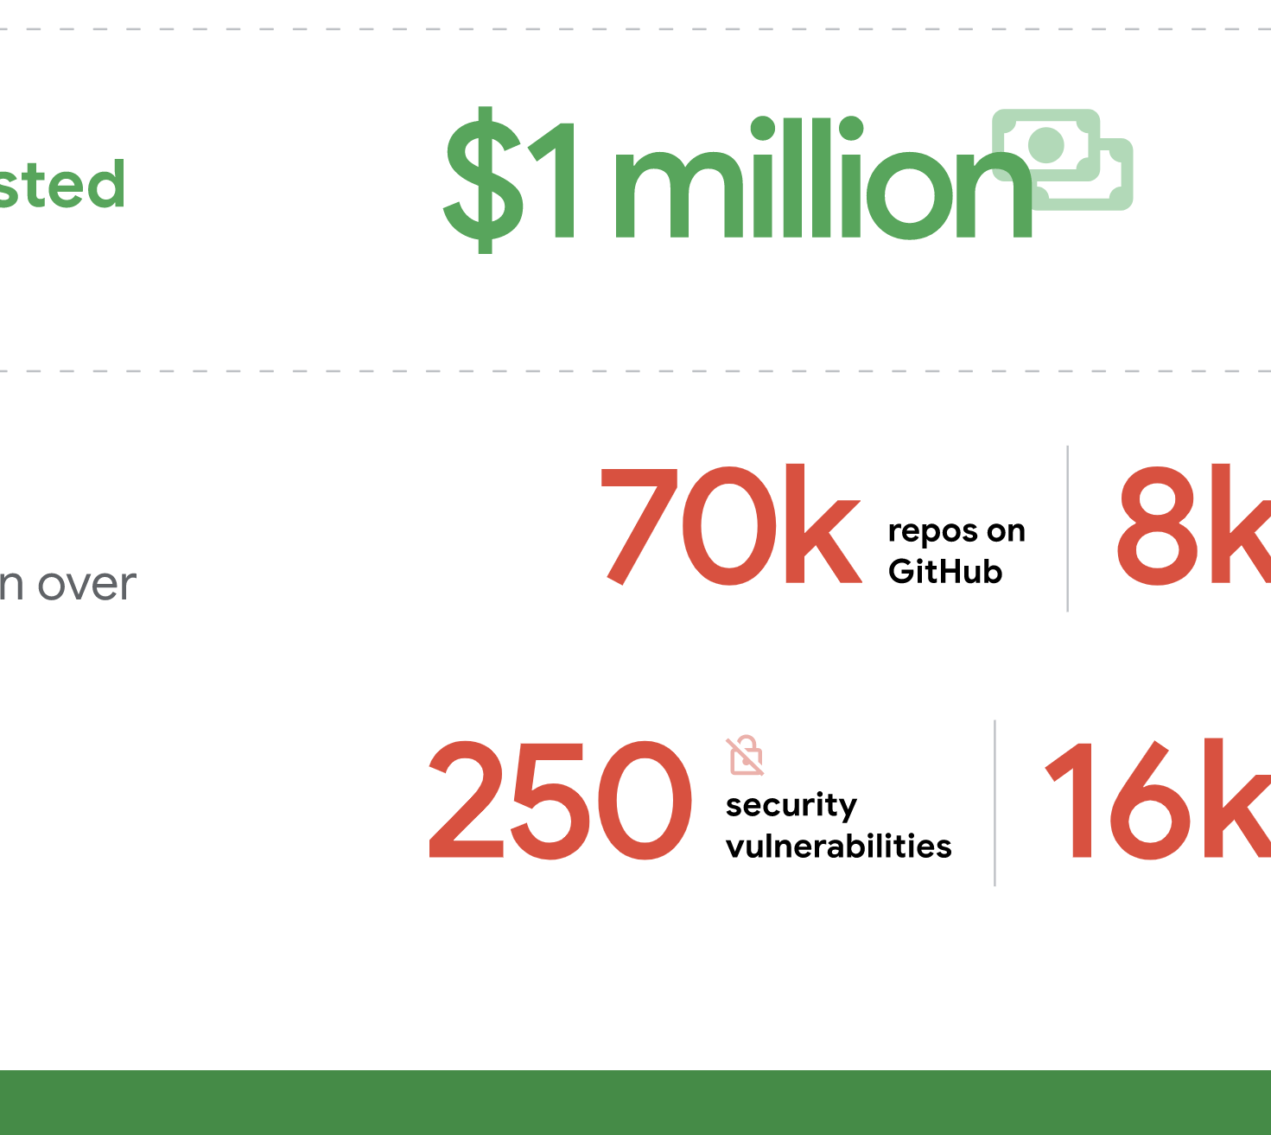
What is Open-Source Software ?

Slide 12
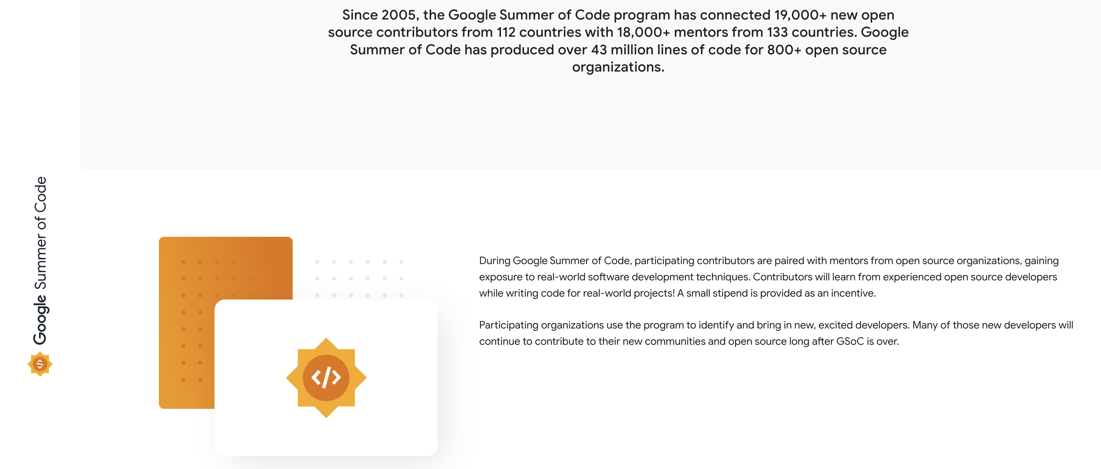
What is GSOC ?
Google Summer of Code is a global, online mentoring program focused on introducing new contributors to open-source software development.
GSoC contributors work on a 12+ week programming project with the guidance of mentors from their open-source organization.

Slide 13
Benefits of Open-Source contribution
Get a chance to up skill yourself
Code, get feedback for contribution, improve, learn
Paying back to the community, global recognition
Make the software better with code and documentation
Meet like-minded people, build networks and communities
Understand the application development and maintenance cycles
Job opportunities
Reading few lines of code is worth more than reading 500 pages of a book, you automatically tend to pickup some great practices while coding.

Slide 14
Open-Source Myths
I don't know to code. Open Source is not my cup of tea.
I know how to code but I'm not familiar with the technology used in this Open-Source project.
I cannot contribute.
Open Source doesn't maintain an enterprise-level standard.
Open-Source Software is always free.
Open Source is for beginners.

Slide 15
ROLES IN TYPICAL OPEN-SOURCE PROJECT
Author/Owner
Maintainers
Contributors
Community Members/Users

Slide 16
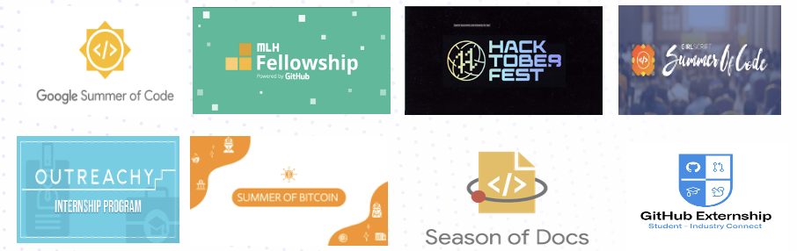
Open-Source communities & events

Slide 17
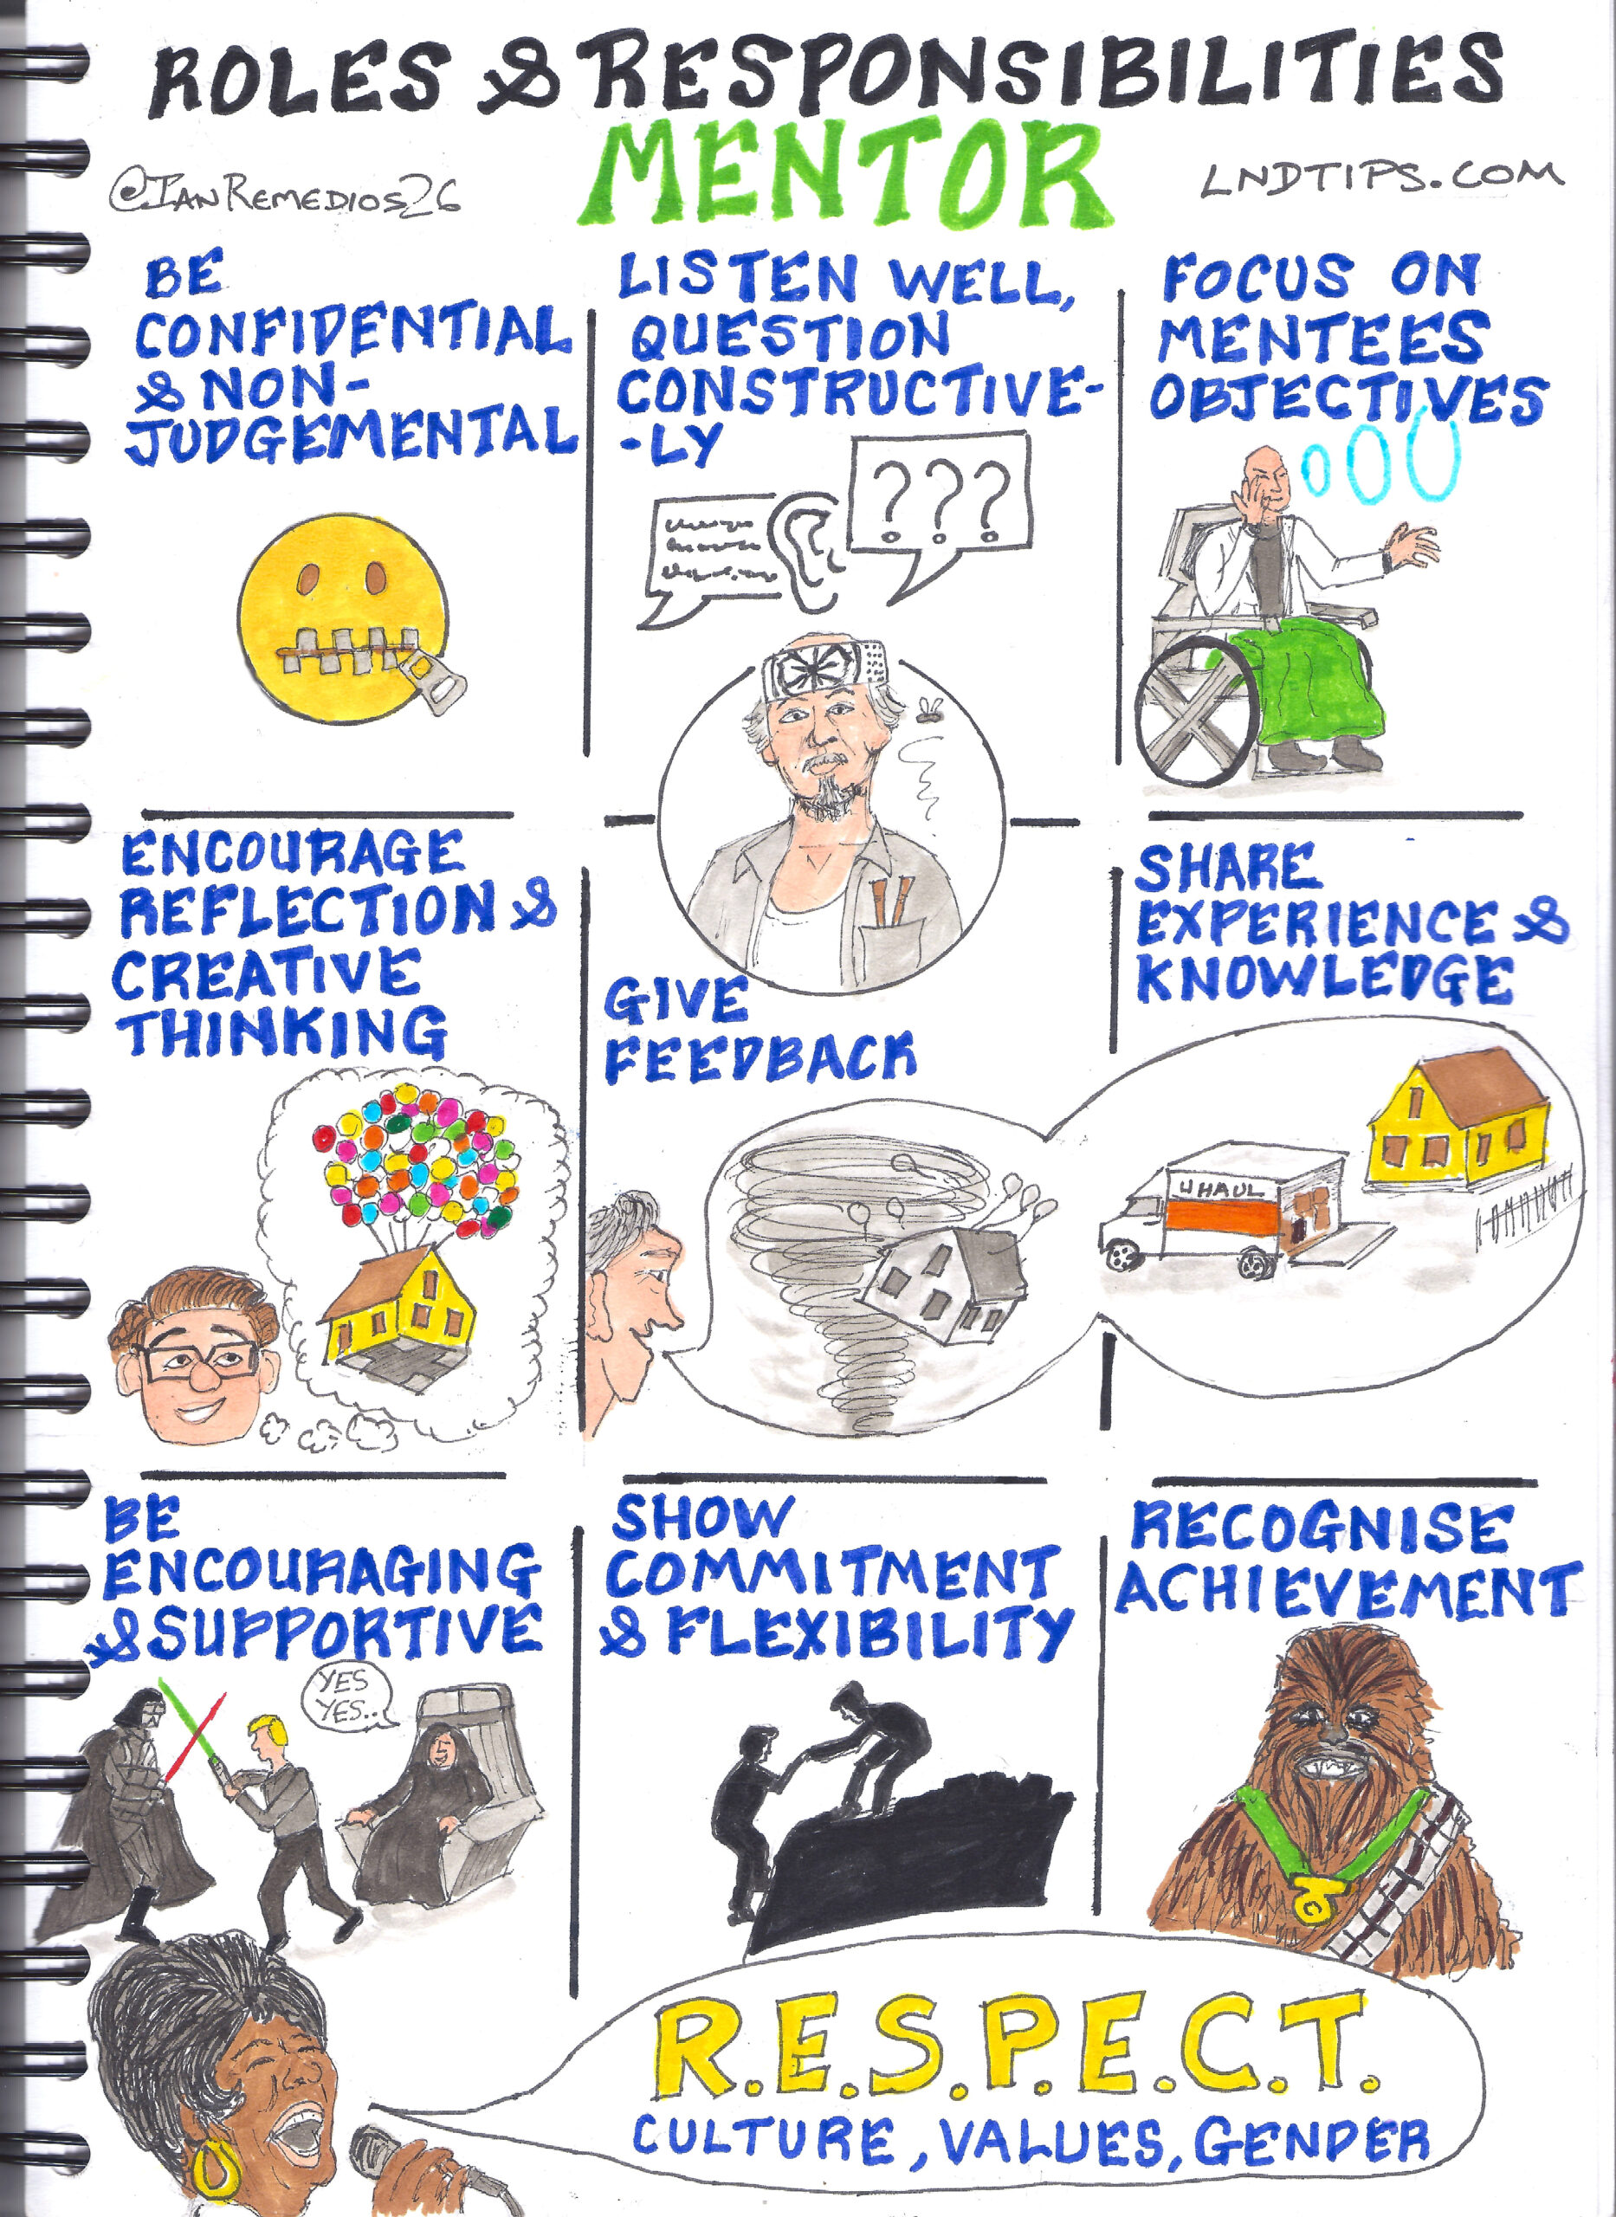
GSOC MENTOR EXPERIENCE

Slide 18
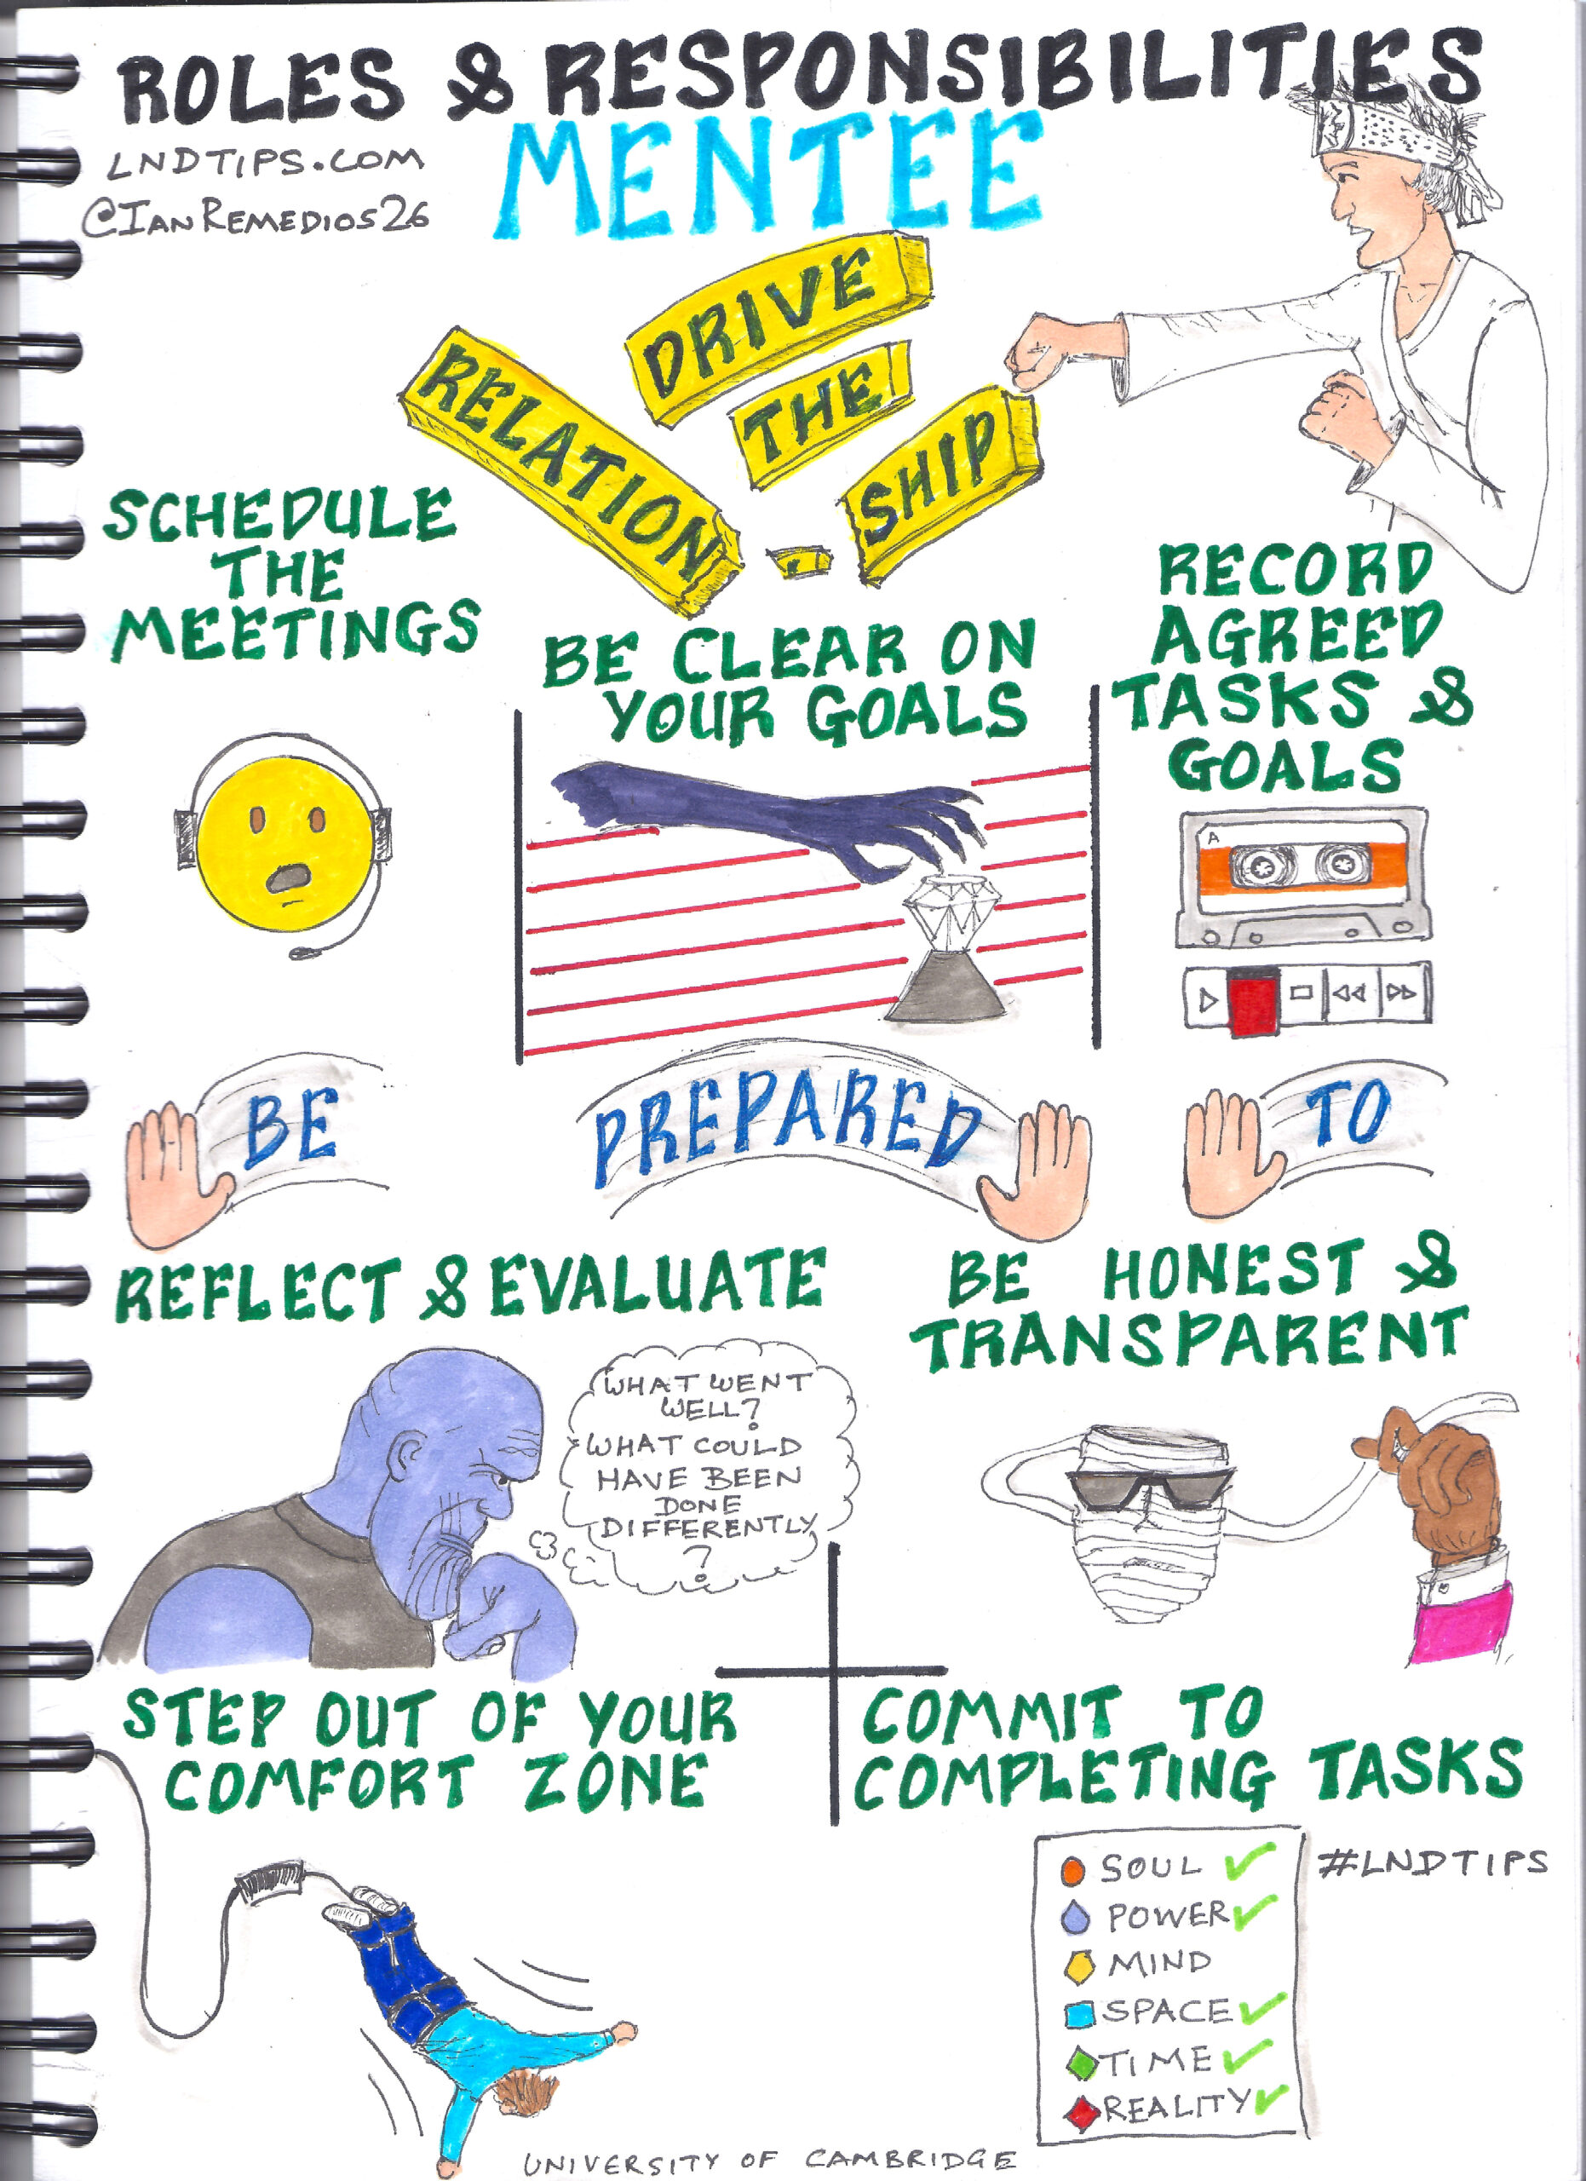
GSOC MENTEE EXPERIENCE

Slide 19
How to chose an open-source project
Project with License file and following Open-Source guidelines
Project, community, Maintainers are active
Availability of Good First Open issues
PRs getting merged actively, Issues getting closed
Active discussions, meetings in community forums
Appreciating environment

Slide 20
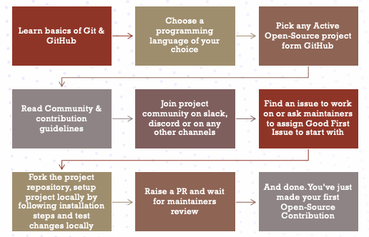
How to get started with open source

Slide 21
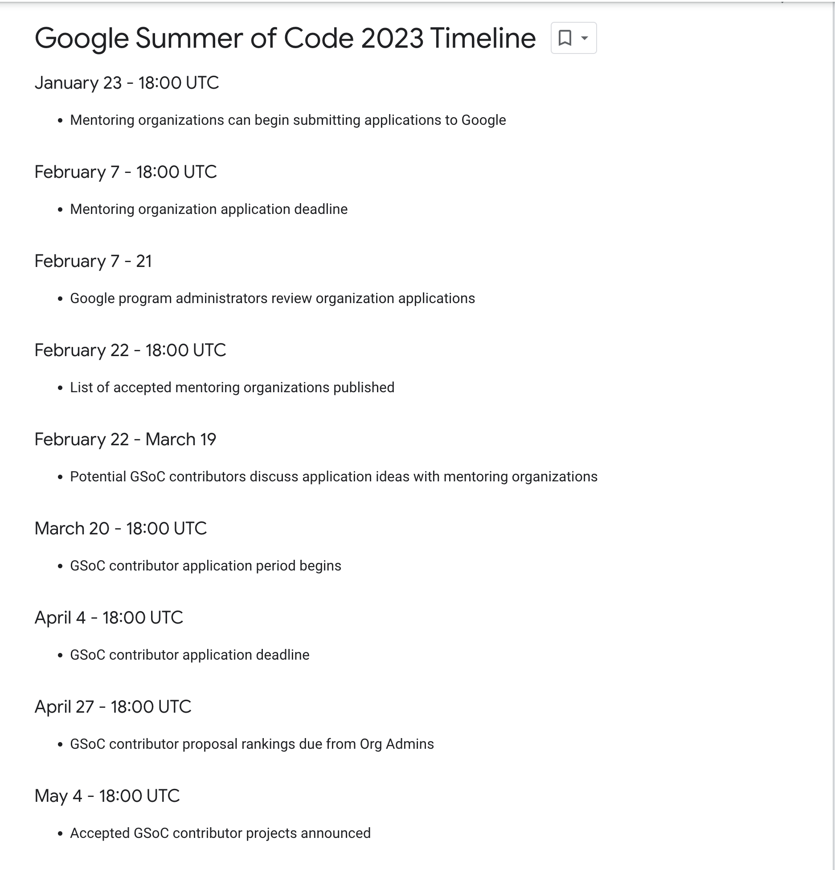
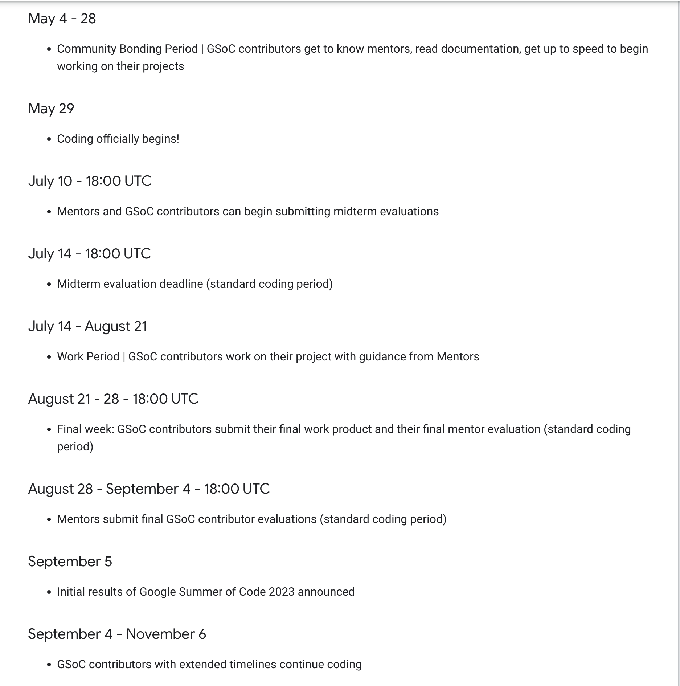
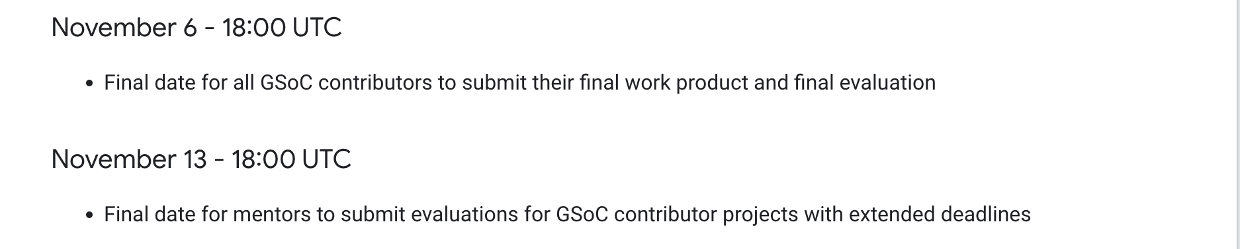
GSOC Timeline

Slide 22
How to chose an GSOC Organization & project
Create profile on GSOC page
Search project/Org based on skills
Join community channels & introduce yourself
Go through community & contribution guidelines
Go through previous recordings. Attend project meetings regularly.
Setup project locally
Check ideas page list
Fix easy good first issues & start working on idea side by side
Learn & help others

Slide 23
Contribute to The Palisadoes Foundation & PEcAN project
The Palisadoes Foundation
- Ideas page : https://docs.talawa.io/docs/internships/internship-ideas/
- Application template : https://docs.talawa.io/docs/internships/internship-application-template/
- Selection Criteria : https://docs.talawa.io/docs/internships/internship-selection-criteria
- GSOD Page : https://docs.talawa.io/docs/internships/gsod/gsod-ideas
PEcAN Project
- Ideas page : https://pecanproject.github.io/gsoc_ideas.html
- Contribution Guide : https://pecanproject.github.io/gsoc.html
- Tutorials : https://pecanproject.github.io/tutorials.html
Sample GSOC Proposal : https://drive.google.com/file/d/1fEE04i0f5yKs25W4-HYth7ni0eerqSCU/view

Slide 24
Do’s AND DON’TS
Patience is the key
Be Curious, responsive
Build welcoming and helping community
Be humble
Avoid overcommitment and over communication
Appreciate and respect others – They are also Humans
Find a good mentor or group of people
Every contribution matters – irrespective of the lines of code
Documentation, meetups, teaching, maintaining community is also part of Open-Source contribution
Start small to go big
Do proper research – Go through readme.md, contributing.md, recorded sessions and attend meetings
Share your learnings with others
Experiment, try, fail, fail again, fail better

Slide 25
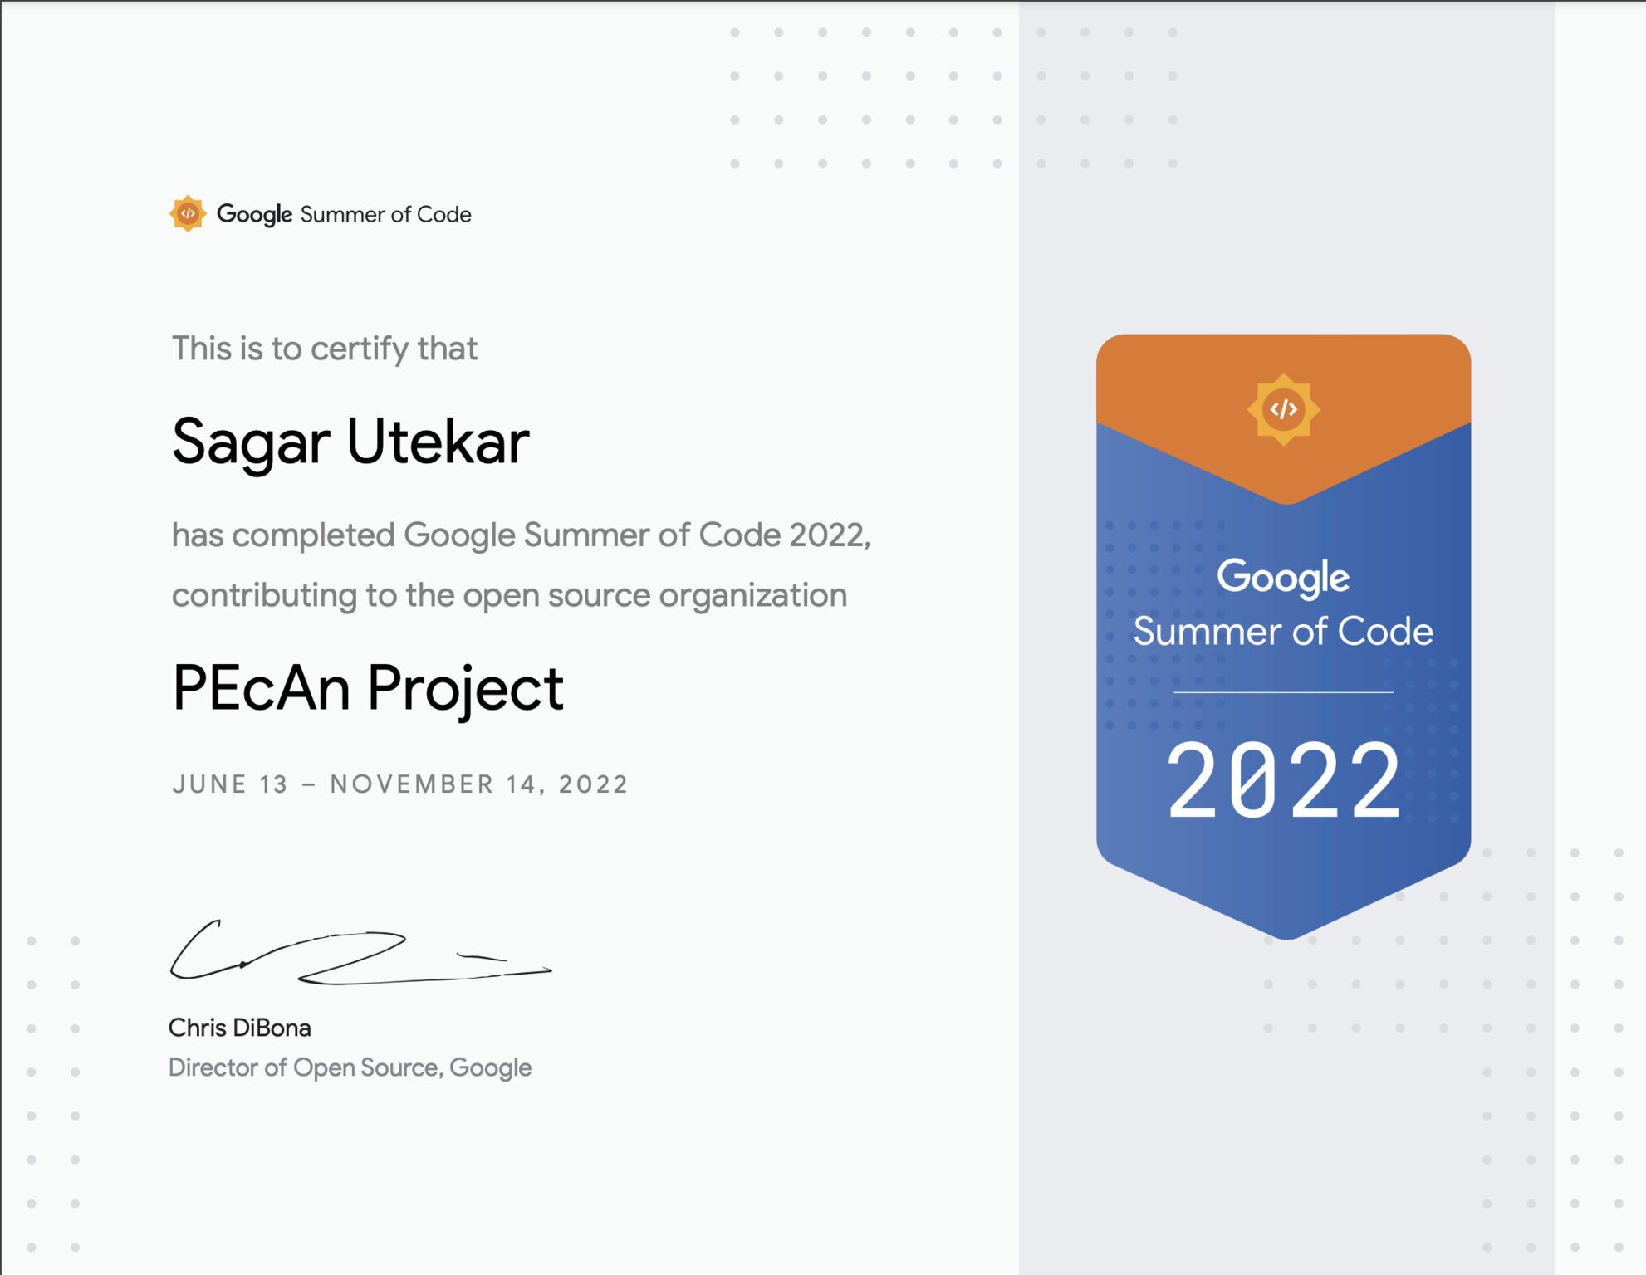
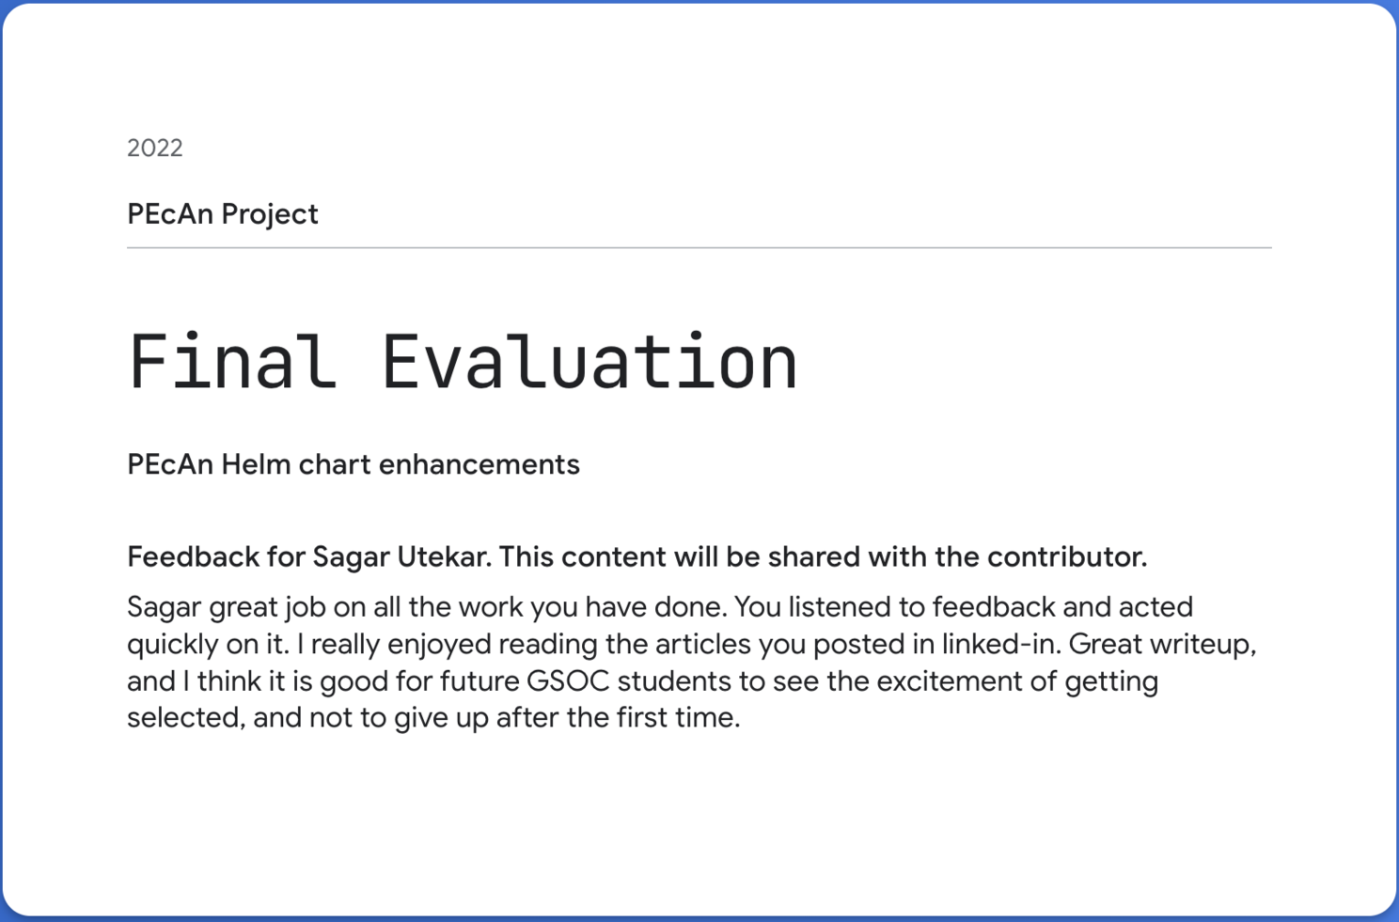
GSOC Certificate & mentor review

Slide 26
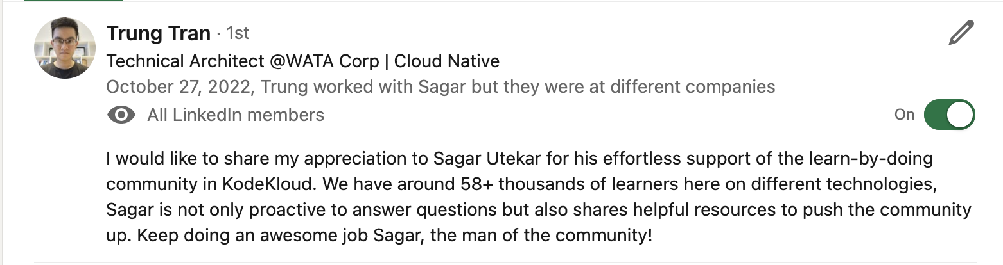
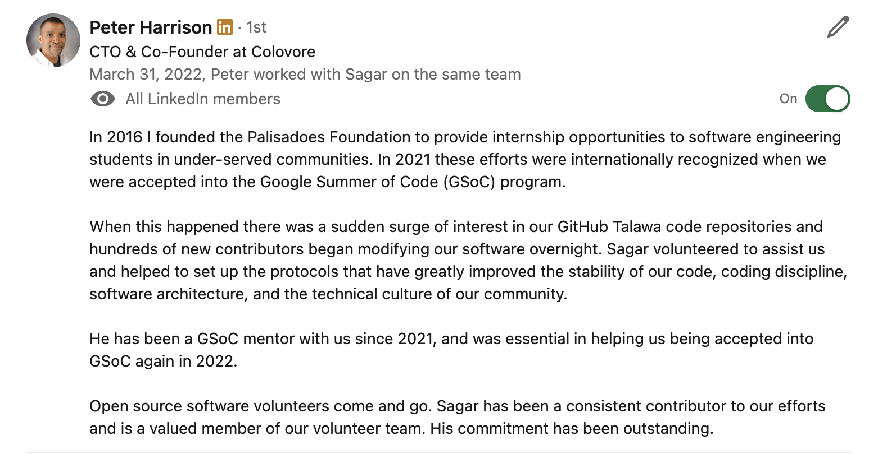
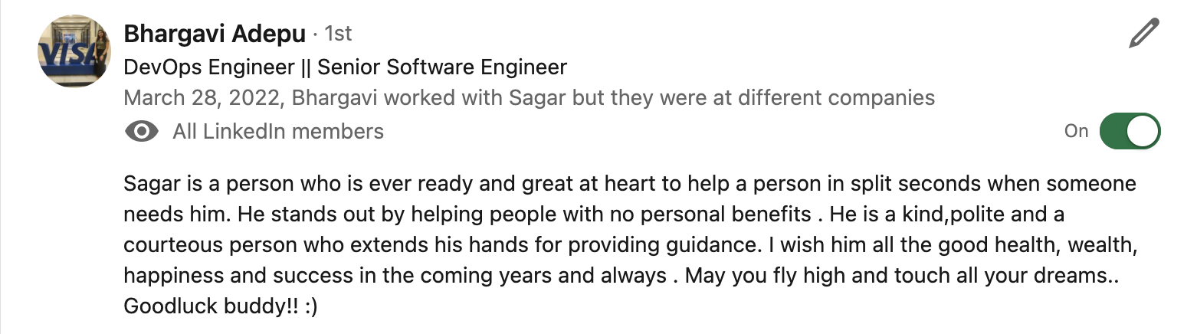
TESTIMONIALS

Slide 27
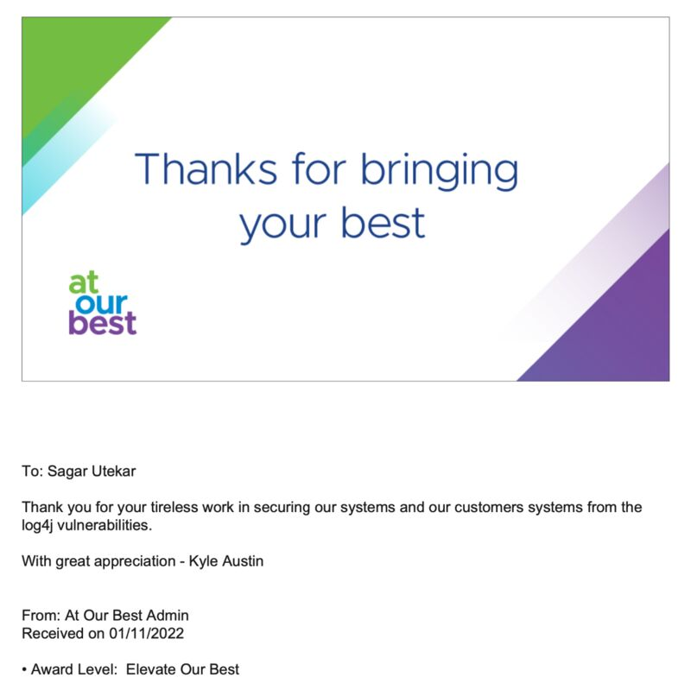
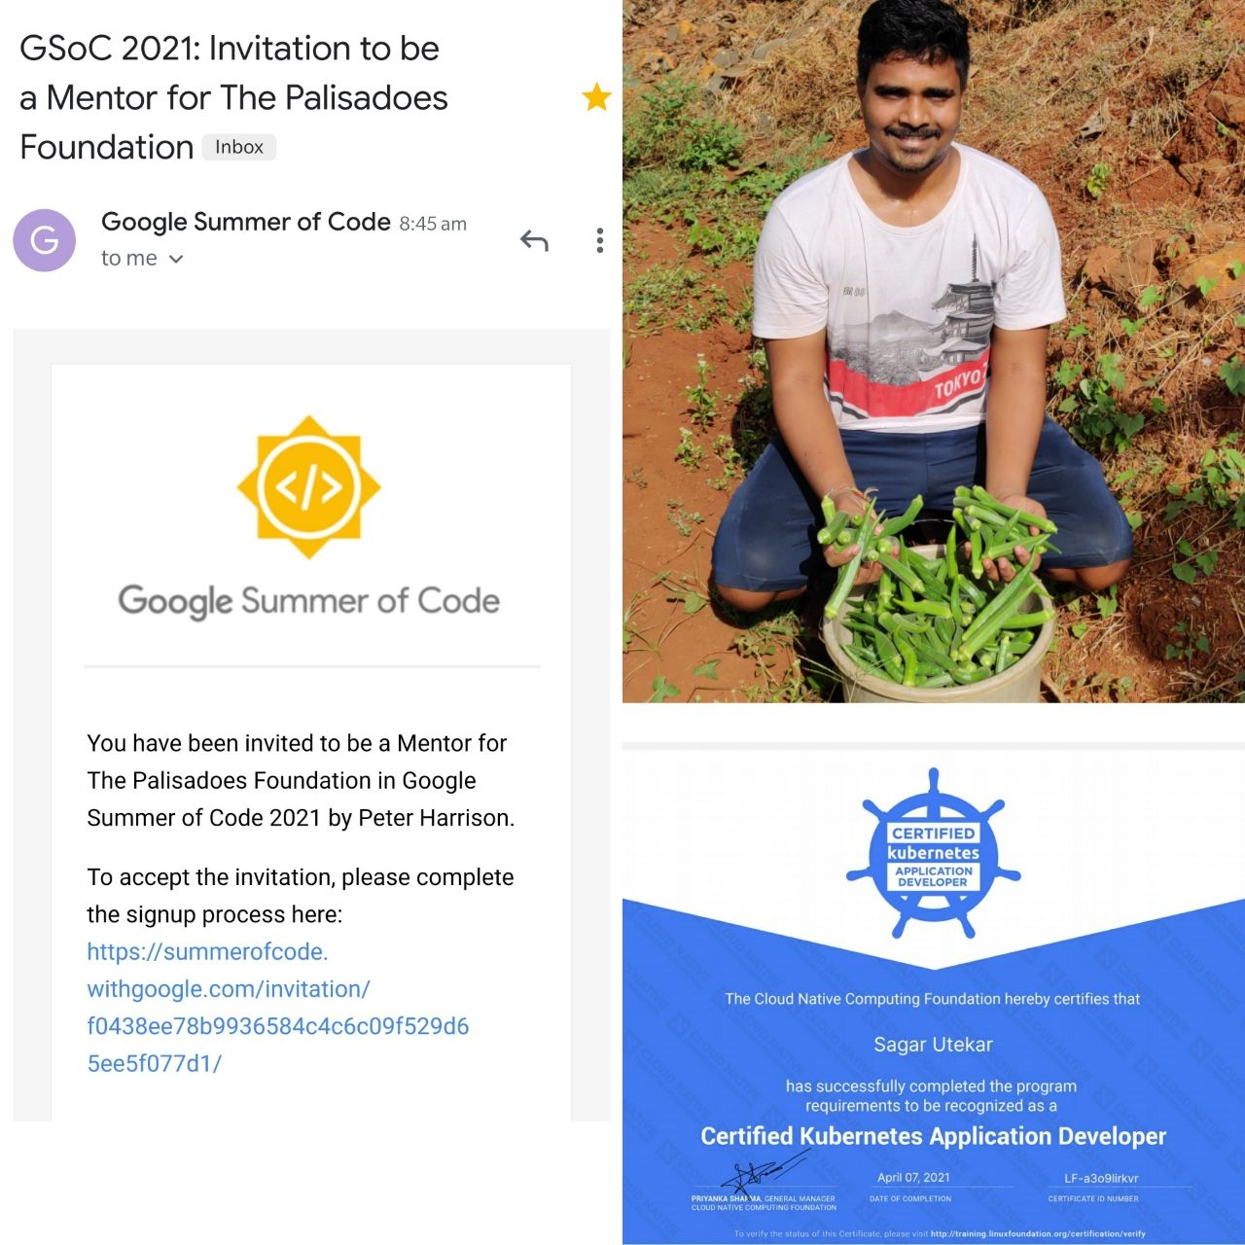
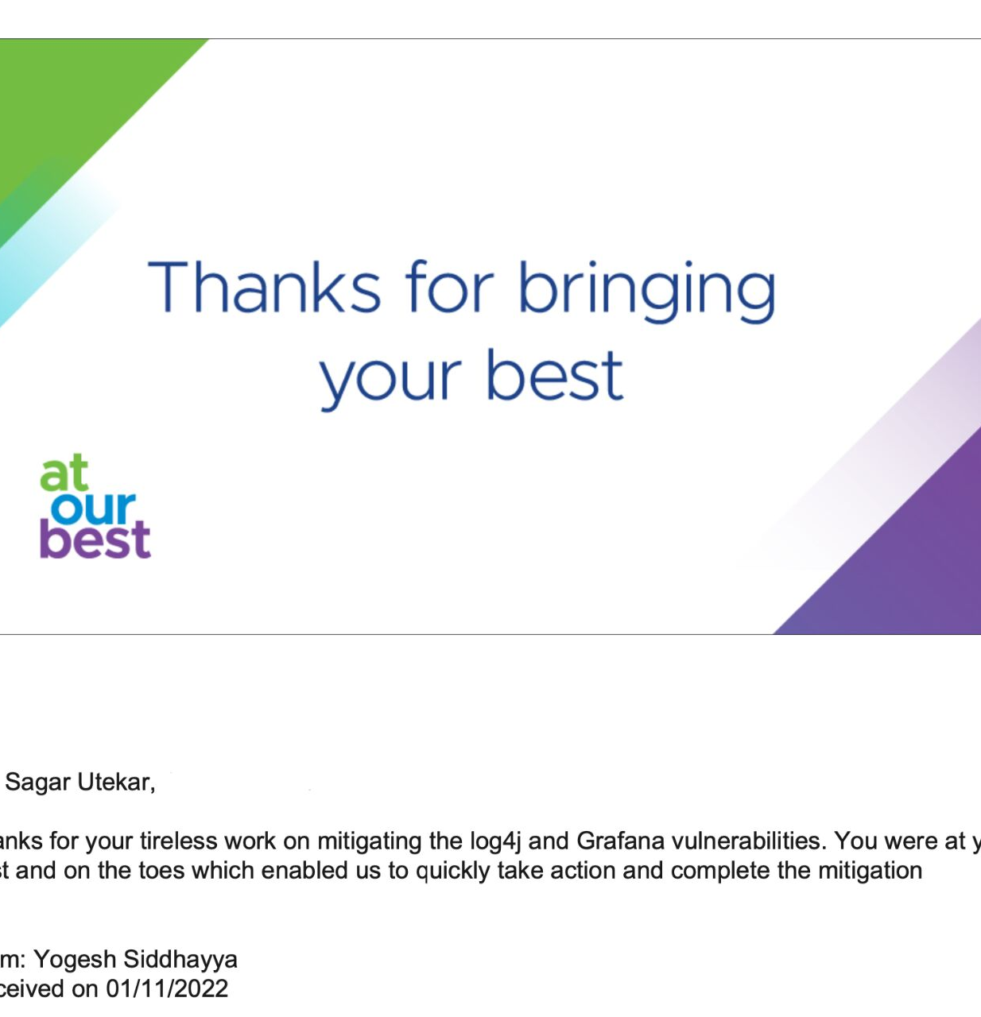
Balancing between interest and office work

Slide 28
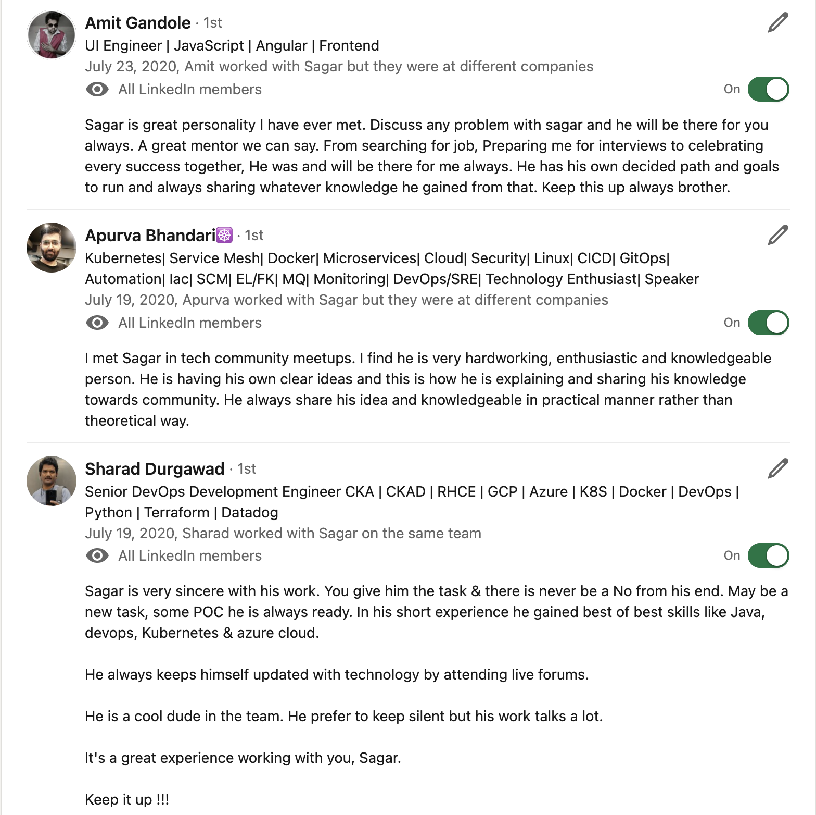
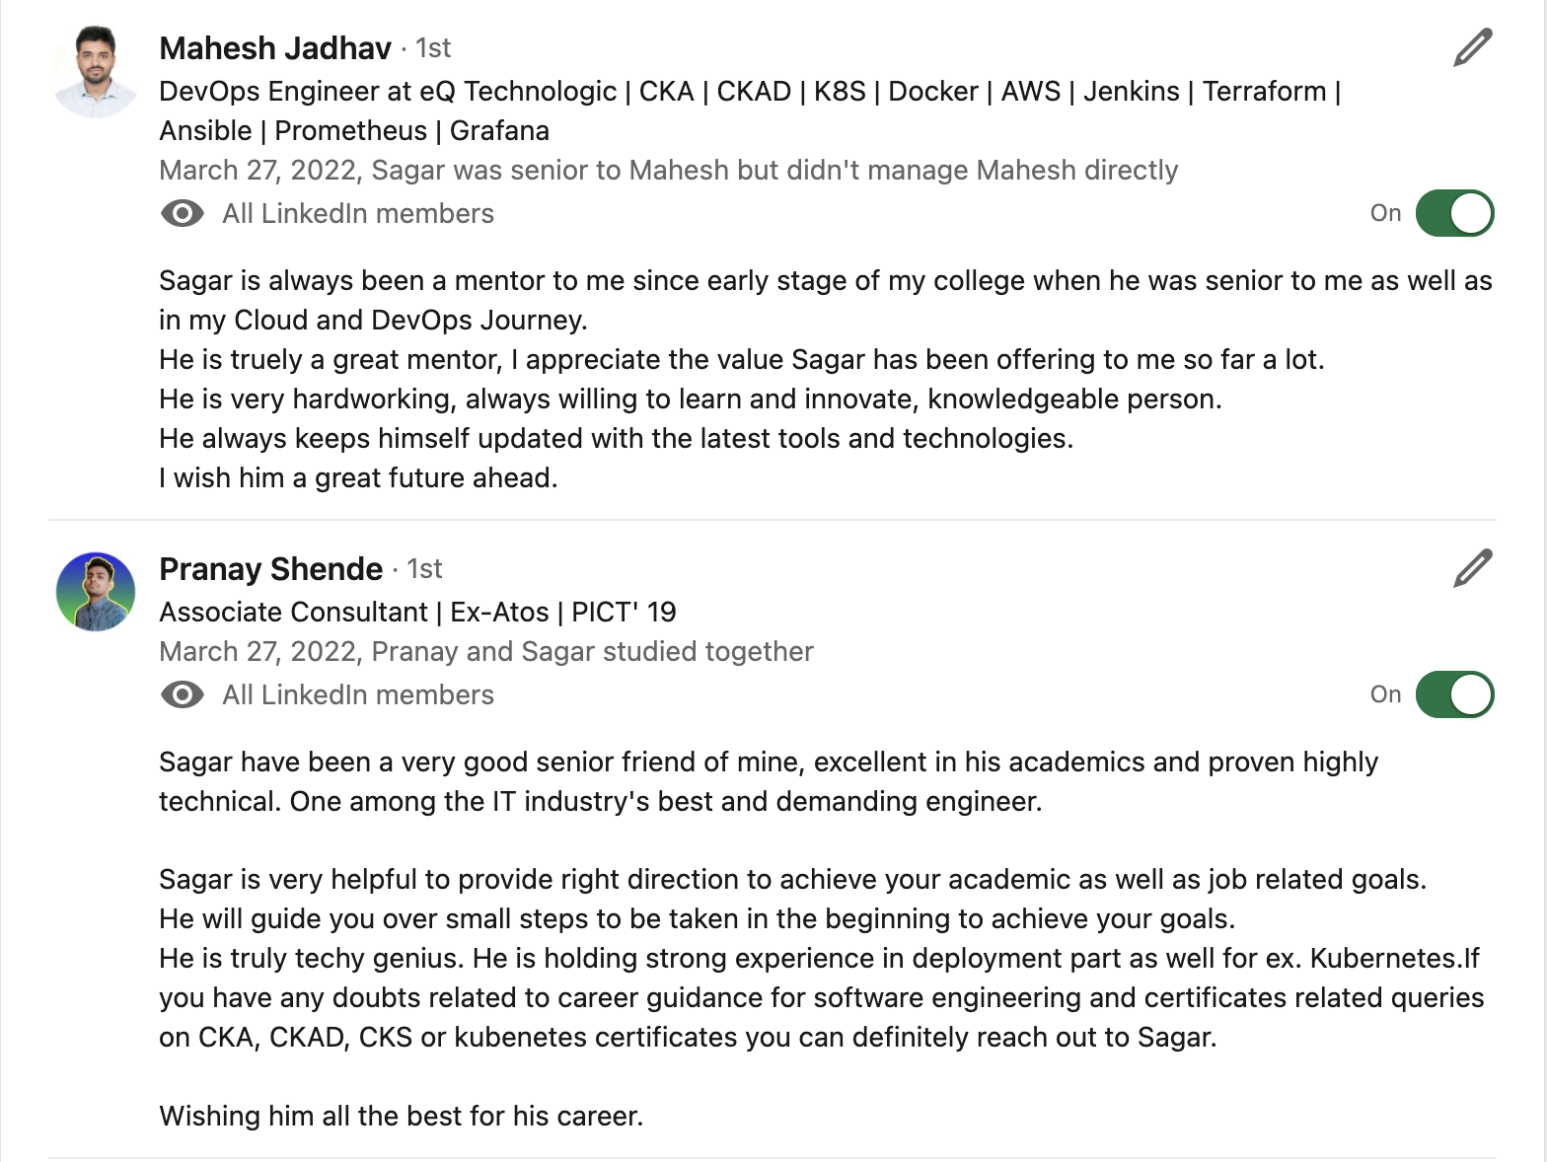
TESTIMONIALS

Slide 29

Community Links
Docker Pune Slack - https://lnkd.in/dyV7VDK6 Docker Pune LinkedIn group - https://lnkd.in/dDZdJRV7
Docker Pune meet-up group - https://lnkd.in/dJhqR8Cj
CNCF Pune meetup group - https://community.cncf.io/pune/
PEcAN Project Slack - https://pecanproject.github.io/contact.html
The Palisadoes Foundation Slack - https://www.palisadoes.org/slack/

Slide 30




CONNECT WITH ME
https://www.linkedin.com/in/sagar-utekar/
https://twitter.com/me_sagar_utekar
https://github.com/Sagar2366

Slide 31
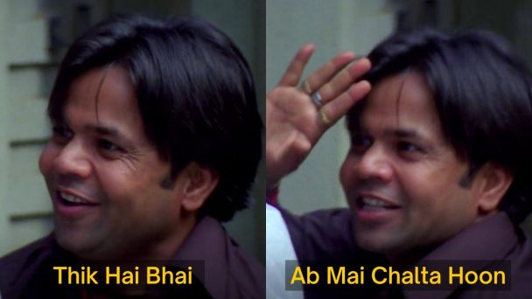
Thank You

